Slide 1
December 2019
Developments in Safeguarding:
Manager’s Masterclass

Slide 2
Housekeeping
Mobiles and Tablets
Timekeeping
Cancellation & Charging Policy
Fire alarm
Comfort
Questions
Resources & website

Slide 3

Get Social
@NYSCP1
#nyscp

Slide 4
Aims of the day…
An update of current issues within child safeguarding and an overview of the current work taking place with North Yorkshire Safeguarding Children Partnership team.
Be aware of relevant changes which impacts on safeguarding practice
To understand any changes in relevant legislation, procedures and consultations in place that impact upon the work of practitioners and managers.

Slide 5
1st Half of Today
NYSCP Update
Break
Domestic Abuse Update

Slide 6
James Parkes
NYSCP Partnership Manager
NYSCP Updates

Slide 7

Getting to know you…
To the person next to you find out the following:
  What is their name?
  What they do for a Job?
  What they want to get from today?
  Interesting fact about them!

Slide 8

NYSCP Overview
The 3 safeguarding partners should agree on ways to:
  co-ordinate their safeguarding services;
  act as a strategic leadership group in supporting and engaging others;
  implement local and national learning including from serious child safeguarding incidents.
To fulfil this role, the three safeguarding partners must set out how they will work together and with any relevant agencies.
All 3 safeguarding partners have equal and joint responsibility for local safeguarding arrangements.

Slide 9
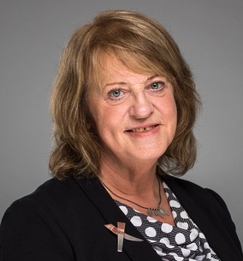
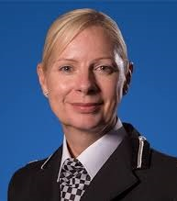
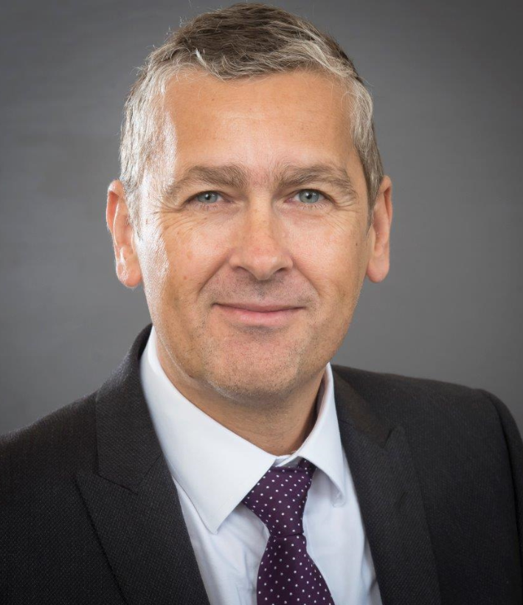
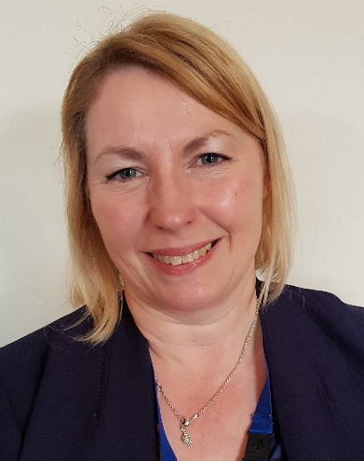
Who’s who…?
Dr Maggie Atkinson
Independent Scrutineer
Annette Anderson
Assistant Chief Constable,
North Yorkshire Police
Stuart Carlton
NYCC Corporate Director, Children and Young People’s Service
Sue Peckitt
Chief Nurse
North Yorkshire Clinical Commissioning Groups

Slide 10

NYSCP Published Arrangements
Live from 29th September 2019
Download the full document here:
https://www.safeguardingchildren.co.uk/about-us/who-we-are/

Slide 11
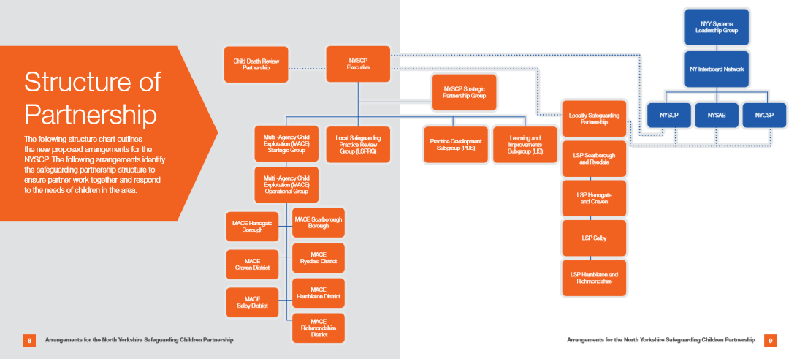

Slide 12
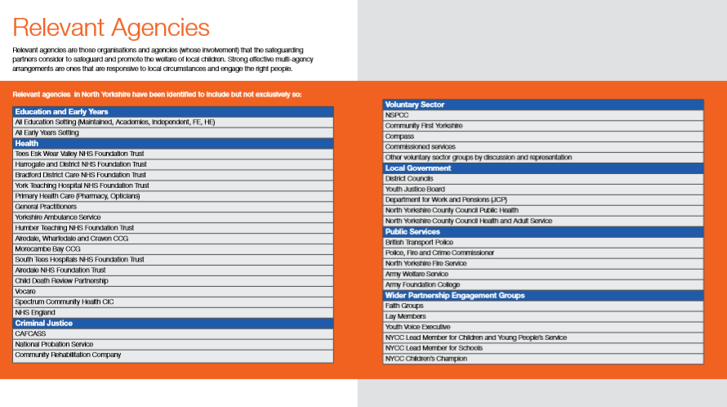
Relevant Agencies

Slide 13
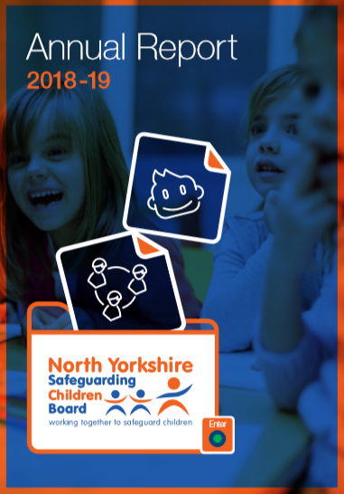
NYSCP Annual Report

Slide 14

North Yorkshire - Early Help Strategy
The aim of Early Help is to build on people’s capacity and resources to manage their own dilemmas, resolve their own difficulties and prevent further problems in the future. Early Help is the response offered by all services in North Yorkshire who are in contact with children, young people and families when an unmet need is identified as outlined in Working Together to Safeguard Children (2018).
https://www.safeguardingchildren.co.uk/professionals/early-help/

Slide 15

ICON – Babies Cry, You Can Cope
The ICON programme delivers four simple messages before the birth and in the first few months of a baby’s life:
I – Infant crying is normal;
C –Comforting methods can help;
O – It’s OK to walk away;
N – Never, ever shake a baby.
Notes:
This month saw the regional launch of an innovative new programme to support parents manage normal infant crying and to prevent abusive head trauma injuries to babies caused by shaking, also referred to as ‘shaken baby syndrome’. ‘ICON – Babies Cry, You can Cope’ (ICON) is an evidenced-based programme designed to help parents and carers understand the normal crying pattern of young infants and to help them develop successful coping mechanisms to deal with this.
These ICON messages have been demonstrated to help parents and carers manage the stresses which can be caused by normal infant crying. Midwives, Health Visitors and other professionals across the region have developed ICON expertise to help give parents and carers the tools they need to help keep their babies safe.
The ICON project was developed by Dr Sue Smith (founder and programme advisor) and builds on research completed as part of her PhD studies around abusive head trauma in infants, and on similar preventive projects studied across North America and Canada. The programme is manged on a national basis by Hampshire Safeguarding Children Partnership.
The North Yorkshire and York ICON programme is funded and supported by local partners including NHS commissioners, NHS provider organisations and Public Health commissioners. This system-wide regional approach will ensure consistent and sustained messaging for parents and carers about infant crying.

Slide 16
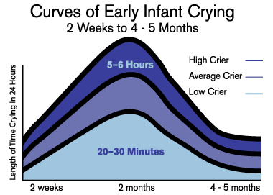
Normal Crying curve

Slide 17
North Yorkshire and York Implementation
The ICON message will be discussed at several “touch-points” throughout pregnancy and in the post-natal period:
During pregnancy (Community midwives and Health Visitors)
Following delivery (Hospital midwives)
Post-natal home visit (Community midwives)
New birth visit (Health Visitor)
5. 3 week phone text (in North Yorkshire only)
6. 6 week baby check (GP)

Slide 18
ICON – Babies Cry, You Can Cope
This programme is being implemented in partnership by:
Airedale Hospital NHS Foundation Trust
City of York Healthy Child Service
Harrogate and District NHS Foundation Trust
NHS Hambleton, Richmondshire and Whitby Clinical Commissioning Group
NHS Harrogate and Rural District Clinical Commissioning Group
NHS Scarborough and Ryedale Clinical Commissioning Group
NHS Vale of York Clinical Commissioning Group
North Yorkshire Healthy Child Service
South Tees Hospitals NHS Foundation Trust
York Teaching Hospitals NHS Foundation Trust
More information and resources to support the ICON programme are available on the dedicated ICON website at http://iconcope.org/

Slide 19

Kooth.com
Kooth.com is an award winning and innovative online counselling and support service which is now available to all young people aged 11-18 years in North Yorkshire.
Kooth’s fully trained and qualified counsellors and emotional wellbeing practitioners are available weekdays 12pm until 10pm and weekends 6pm until 10pm, 365 days per year, providing out-of-hours service for emotional support in an accessible way. In 2018-19, Kooth.com was accessed by over 130,000 young people across England.
Notes:
A counselling, advice and support service called Kooth.com is now available for children and young people in North Yorkshire. The service has been commissioned by Tees, Esk and Wear Valleys NHS Foundation Trust for North Yorkshire and by Airedale Wharfedale CCG for Craven and is supported by local Clinical Commissioning Groups (CCG) and North Yorkshire County Council.
Kooth.com is an award winning and innovative online counselling and support service which is now available to all young people aged 11-18 years in North Yorkshire. It is a safe, confidential and anonymous way for young people to access emotional wellbeing and early intervention mental health support. Kooth’s fully trained and qualified counsellors and emotional wellbeing practitioners are available weekdays 12pm until 10pm and weekends 6pm until 10pm, 365 days per year, providing out-of-hours service for emotional support in an accessible way. In 2018-19, Kooth.com was accessed by over 130,000 young people across England.
Kooth.com has been developed by an organisation called XenZone. To ensure that
teachers and other education specialists know about Kooth.com and understand what it can offer in order to refer or signpost young people they can arrange awareness sessions. This could be as part of training days, twilight sessions or even lunchtime sessions as it takes 30 minutes to give a presentation with a Q&A period.

Slide 20
If you are interested in arranging a date, would like more information before then or to book free awareness training or regarding joint working please contact
Emma Handford, Integration and Participation Worker, ehandford@xenzone.com
For queries related to Craven
erichards@xenzone.com

Slide 21
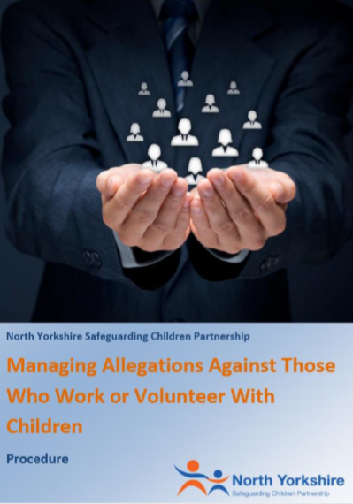
Managing Allegations Against Those Who Work or Volunteer with Children Procedure
In accordance with Working Together (2018), where an organisation has received an allegation that a volunteer or member of staff who works with children has:
behaved in a way that has harmed a child, or may have harmed a child;
possibly committed a criminal offence against or related to a child; or
behaved towards a child or children in a way that indicates they may pose a risk of harm to children
You should contact the Duty Local Authority Designated Officer (LADO) on 01609 532477.
https://www.safeguardingchildren.co.uk/professionals/practice-guidance/

Slide 22
What do you think NYSCP’s Priorities should be?
?

Slide 23
Domestic Abuse Update
Odette Robson
Head of Safer Communities, NYCC

Slide 24

Domestic Abuse Update
Domestic Homicide Reviews
‘Julie’
Domestic abuse arrangements in North Yorkshire and York

Slide 25
Current DA definition
Any incident or pattern of incidents of controlling, coercive or threatening behaviour, violence or abuse between those involved 16 or over, who are or have been intimate partners or family members regardless of gender or sexuality

Slide 26
Domestic Homicide Reviews
Death of a person aged 16 or over
Resulted from violence, abuse or neglect by
A person whom he/ she was related or had been in an intimate personal relationship; or

Slide 27
Domestic Homicide Reviews
A member of the same household
Held with a view to identifying the lessons from the death

Slide 28
Domestic Homicide Reviews
“ where a victim took their own life (suicide) and circumstances give rise to concern, for example it emerges that there was coercive, controlling behaviour in the relationship, a review should be undertaken, even if a suspect is not charged with an offence or they are tried and acquitted”

Slide 29
National Picture
2018- 173 people were killed in domestic violence related homicides
75% of victims of domestic killings by a partner, ex-partner or family member were women

Slide 30
National Picture
“invisible victims of knife crime”
“that’s part of the issue about violence against women, it mostly remains invisible”
Professor Sandra Walklate, Liverpool University

Slide 31
Key Findings
Among both men and women the highest proportion of domestic homicides was among those aged 30-50 (40%)
Most common method of killing was by a knife or a sharp instrument

Slide 32
Analysis Group (40)
33 intimate partner homicides, 15 included dependent children
Mental health issues present in 25 of the 33
In 24 of the 33, the perpetrator had a history of violence

Slide 33

Analysis Group (40)
7 ‘familial’ homicides
6 of these cases involved the son killing a parent
In 6 of the 7 substance use by the perpetrator was noted
In all 7 mental health issues were a factor

Slide 34
Themes- Intimate Partner (33)
Record keeping 22 (66%)
Risk assessment 27 (82%)
Communication and information sharing 25 (76%)
Known possible signs of DA 24(73%)
‘Training’ highest proportion of recommendations

Slide 35
Julie
www.nypartnerships.org.uk/dhr
“Confident, outgoing and independent”
“Julie loved the outdoors and being active and enjoyed holidays”

Slide 36
Family involvement
https://vimeo.com/167567940

Slide 37
Julie
Marcus “has taken every bit of happiness out of this family. She was the force within the family that held the family together”
“She pulled me up if I was going down. She never let me sink.”

Slide 38
Julie
21st August 2013
Julie reported DA to the Police
Had occurred 4 days earlier while on holiday in Greece
Serious incident
Contact with Marcus’ sons

Slide 39
Julie
28th June 2014
Julie telephoned ‘999’ to report she had been strangled
Secure hospital
October 2014, pleaded guilty at York Crown Court and was detained on a Hospital Order

Slide 40
Julie
March 2015 discharged to the care of community health services
4 separate MARAC meetings

Slide 41
Julie
5th March 2018
Marcus made a ‘999’ call to police stating he had killed his ex-partner
Notes:
Professionals and Julie’s family advised her to leave the relationship with this violent man. We know that Julie tried repeatedly to support Marcus and was controlled by him either by threats of violence or his repeated suicide attempts.

Slide 42
Key Issues
Good practice
Communication/ record keeping/ information sharing
Risk assessment
Being aware of the ‘child’
On/ off nature

Slide 43
We cannot say with any certainty that the homicide could have been prevented…missed opportunities should be balanced against some of the positive actions taken by agencies to protect Julie. These actions included advice to leave such a violent partner.

Slide 44
Her family also pleaded with her to end the relationship..
Julie did not feel able to make a complete break from this destructive relationship.

Slide 45
Actions
Training
DA- push/ pull factors and pressure on victims
Risk assessment
Child focus “putting the child at the centre of their thinking irrespective of the reason they are involved”
Stalking and harassment

Slide 46
Actions
Processes
Closure of incidents
Flagging
Record keeping- cross reference
Review of MARAC arrangements

Slide 47
DA arrangements
Domestic Abuse Joint Coordinating Group- North Yorkshire and City of York
Joint commissioning arrangements
Joint DA strategy

Slide 48
DA arrangements
Victims- IDAS (Young Perps)
Perpetrators- Foundation
Therapeutic Service- Foundation
Re-commissioning refuge and accommodation based services
Further work children and young people

Slide 49
Odette Robson
Head of Safer Communities, NYCC
odette.robson@northyorks.gov.uk

Slide 50
Break

Slide 51
NYSCP Round Up
MACE & Contextual Safeguarding
Substance Misuse in North Yorkshire

Slide 52
MACE (Multi-Agency Child Exploitation) & Contextual Safeguarding
Emma Phillips
NYSCP Policy & Development Officer

Slide 53

Introductions
Emma Phillips,
NYSCP Policy and Development Officer,
Emma.Phillips@northyorks.gov.uk

Slide 54
Today’s aims
Provide an overview of the new MACE Arrangements
Explore the different structures within MACE and how you fit within these structure
Look at how you might identify contextual safeguarding concerns within your practice
Notes:
In November 2013 the Deputy Children’s Commissioner published ‘If Only Someone Had Listened’ a report relating to a national inquiry into Child Sexual Exploitation (CSE) in Gangs and Groups. In August 2014 the Independent Inquiry into Child Sexual Exploitations in Rotherham was published by Professor Alexis JAY, OBE (also known as the JAY report). The report highlighted serious concerns about how partner agencies had dealt with cases and identified the need for proactive approaches. The findings indicated a “collective failure” by the Council and Police to stop CSE. Senior Managers within Children’s Social Care were said to have underplayed the scale and seriousness of the problem. Police were said to have given CSE no priority, regarding many child victims with contempt and had failed to treat the abuse as a crime. The JAY report made a total of fifteen recommendations. In 2015 The Inspection of the Rotherham Metropolitan Borough Council Report (also known as the CASEY report) resulted in the Council being deemed not fit for purpose in responding to CSE. CSE has remained of national concern and high profile and was identified by the Home Office as a national priority. In March 2015 in response to the reported failures, the Government produced Tackling Child Sexual Exploitation a government action plan.
North Yorkshire Safeguarding Children Board (NYSCB) established a multi-agency CSE protocol in September 2011 and developed a strategy to address issues of CSE countywide. A significant amount of work has been undertaken since this time at both strategic and operational level to identify and effectively target CSE.
In June 2015 the NYSCB approved the introduction of the VEMT (Vulnerable, Exploited, Missing and Trafficked) Procedures and VEMT Practitioner Groups (VPGs) which were then launched across North Yorkshire in October 2015. Due to the on-going level of national concern at the time regarding CSE and the need to have an effective information sharing structure established within North Yorkshire, the initial launch of the VEMT procedure focused on CSE cases only. This ensured a timely implementation programme and a platform to build on once the operational practice was effectively established.
During 2016/17 VEMT and VPG procedure was subject of review and expanded to include additional vulnerabilities. These included CSE, Missing from Home, Modern Slavery and Human Trafficking, Radicalisation and Extremism, Impacted by Domestic Abuse, Forced Marriage, Female Genital Mutilation (FGM) and Honour Based Violence (HBV) as well as other forms of exploitation (coercion and control e.g. being forced to deal drugs and other criminal acts). Further developments at this time, included the development of the North Yorkshire Multi Agency Screening Team (MAST) and resulted in the revision of the procedures to provide clarity in terms of roles, responsibilities and accountability and amendments to operational procedures including the working practice of the VPGs.
In August 2018 the NYSCB established a VEMT Strategic group to review the current VEMT arrangements and to drive a multi-agency response in relation to the VEMT agenda. Upon review of the current arrangements, the decision was made by the group to re-name and re-launch the procedures following the review. The new arrangements aim to ensure that as a multi-agency partnership, we are effectively sharing information; identifying and managing the risk of exploitation; addressing contextual safeguarding; effectively identifying, targeting and pursuing perpetrators of exploitation and harm.
In June 2019 the NYSCB launched the new arrangements under the new name of Multi-Agency Child Exploitation (MACE). These arrangements replaced and enhanced the previous VEMT Arrangements across North Yorkshire.
These procedures and associated documents replace previous VEMT documents.

Slide 55

MACE
Child Sexual Exploitation (CSE)
Child Criminal Exploitation (CCE) including county lines
Missing from Home (MFH)
Modern Slavery and Human Trafficking
Harmful Sexual Behaviour (HSB)
Online Child Exploitation
Notes:
Part of the review included clarity around which vulnerabilities MACE would incorporate and as part of the MACE Strategic group it was agreed that MACE would act as an umbrella term the incorporates the following vulnerabilities:
Child Sexual Exploitation (CSE)
Child Criminal Exploitation (CCE) including county lines
Missing from Home (MFH)
Modern Slavery and Human Trafficking (MSHT)
Harmful Sexual Behaviour (HSB)
Online Child Exploitation (OCSEA)
The online world is something that we need to develop across the county. We need to ensure that we understand the online world of the children we are working with, as well as their traditional offline world. We need to understand what risks children may be exposed to online and what harms they may come across as well as what harmful adults there may be around that child both online and offline.

Slide 56



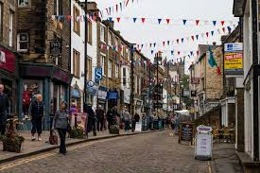



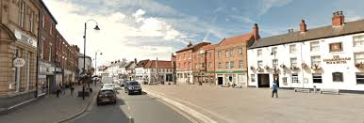
Scale of the challenge
Notes:
Largest county in England
Population in 2016 of over 604,000
Covers 3,341 square miles
365 schools across the county
6 clinical commissioning groups
7 District Councils
East coast mainline bisects the county stopping at Northallerton, Thirsk and York
40% of the county is covered by national parks of which attract 7.93 million visitors annually
Farming is the main industry most children resident in NY have a rural upbringing
Many children grow up in the many market downs and smaller communities in the country
However due to the sparse nature of most of the county children and young people can feel isolated due to the long distances they have to travel to meet friends or use amenities

Slide 57
What is Contextual Safeguarding?
https://www.contextualsafeguarding.org.uk/en/publications/webinars-videos-and-podcasts

Slide 58

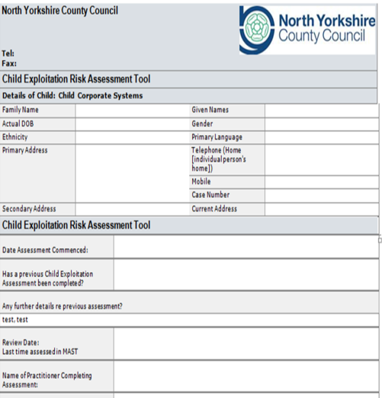



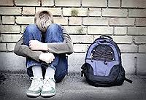
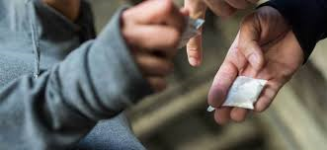

MACE Process
MACE Level 1
Referral
Contextual Safeguarding Concerns
MACE Level 2 Meeting
Exploitation Risk Assessment
MAST Screening
Allocated Worker
Notes:
So how do we identify this vulnerability. The answer is through the eyes and ears in our communities of which you are a vital part. Health staff often known their communities really well, they are a trusted professional. This slide gives a simple summary of how information about a new or emerging concern of exploitation processes through both the Level 1 and the Level 2 MACE arrangements.
Referral – If a professional identifies a concern for a child for exploitation they would submit a referral to the Contact Resolution Centre (CRC) for NYCC in the same way they would for any child safeguarding concern. That referral is then triaged and processed and sent to the MAST Screening Team as a contact to be screened.
MAST Screening – The MAST team are a multi-agency team made up of decision makers from North Yorkshire Police, Children Social Care and Early Help and Harrogate District Foundation Trust (HDFT). Exploitation referrals would traditionally be assessed not just on the submitting information contained within the referral, but also info held on Police, Health or Children and Families info systems. A decision is then made on what needs to happen to ensure that the child receives the right support and help at the right time. Invariably this would then result in the case being sent to a local team to assess the risk of exploitation and look at what support is needed to help that family where there are concerns a child may be being exploited. This may be either Children Social Care or Early Help depending on the needs identified within the case.
Allocated worker – A worker from either Children Social Care or Early Help will then make contact with the child and the family and begin their assessment. This will also incorporate communicating with other professionals who may already be working with that family to obtain an understanding of the risk of exploitation that child is exposed to. This will then contribute to the completion of the Exploitation Risk Assessment by the allocated worker in conjunction with all related professional partners who may be working with the family, the child’s family themselves and includes the child's view as to their worries and the risks as they perceive them.
Exploitation Risk Assessment – Within North Yorkshire we used to use the Bedfordshire Risk Assessment Tool (BRAT), however following national guidance from the National Working Group (NWG) we have now developed the use of their National Tool and incorporated it within the Signs of Safety Framework that is used across North Yorkshire Children and Families Service. This assessment is reviewed within the MAST team by the same multi-agency decision makers from Children Social Care, Early Help, North Yorkshire Police and Harrogate District Foundation Trust and a multi-agency agreement is reached as the level of exploitation risk. The forum offers a platform for scrutiny and challenge across partners and to ensure that there are robust plans in place to manage the risk posed. The Child Exploitation Meetings are held three times a week and although are based in County Hall in Northallerton, have facilities for allocated workers and other lead professionals to call in to the meeting. It also offers a platform for recommendations to be made regarding whether a National Referral Mechanism needs to be submitted and/or consideration for referral to our third sector partners Hand in Hand and Parents Against Child Exploitation or referral onto our Trusted Relationships project.
Locality Tasking Meeting – Currently we are piloting in the East of the County a high level locality tasking meeting whereby there is multi-agency management oversight and scrutiny for the highest risk missing and exploitation cases in the locality to seek assurance that the right resources and plans are in place understand, manage and reduce risk. Themes from this meeting feed into the MACE Level 2 Contextual Safeguarding Meeting. This pilot however is currently being reviewed before consideration is given to rolling it out across the county.
Contextual Safeguarding Concerns – Children within the MACE Level 1 process are all managed through Child Protection Plans, Child in Need Plans, Looked After child Reviews and/or are open to Early Help and these processes offer the framework for the risk assessment and risk management for the risk that that young person is exposed to. However within those detailed case plans are often contextual safeguarding concerns. Themes that may link a number of vulnerable children together. For example, two children open under child in need have been going missing to another local authority to meet older adults or there are a group of young people who have been seen getting into a particular car and taken to parties, given drugs etc. These contextual safeguarding concerns then pass through to the MACE Level 2 Contextual Safeguarding Meeting from the MAST Child Exploitation Meeting that sits at Level 1.
MACE Level 2 Meeting – The MACE Level 2 Meeting is concerned with the links between children at risk of exploitation, locations that may pose a risk of harm, potential harmful adults who are around those young people who may pose a risk of or are exploiting them and the intelligence that links the themes of what the risk is within a locality area. The purpose of the meeting is to identify the risk and put robust multi-agency plans in place to manage and disrupt that risk.

Slide 59
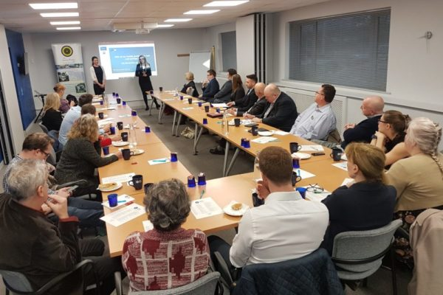
MACE Level 2 Locality Meeting
Multi-Agency Partners
  Police, YJS, Community Safety, Social Care, Schools, CAMHS, No Wrong Door, Hand in Hand, PACE, IDAS, Housing, Private Care Providers, Licencing, Compass, Horizons
Identify perpetrators
Persons of concern – intel development
Identify Locations/Hotspots
Focus on partnership intel sharing
Identify peer group networks
Clear action plans
Focus on disruption and diversion
Notes:
The MACE Level 2 meeting focusses on the sharing of information and intelligence around these contextual safeguarding concerns. It is attended by a wide range of multi-agency partners including:
Core membership within the MACE and Contextual Safeguarding Level 2 will include:
• North Yorkshire Safeguarding Children Board MACE Policy and Development Officer (Chair) • North Yorkshire Police (representatives to include Safer Neighbourhood Inspector or Sergeant, Police Community Support Officer Representative and Police Intelligence Officer • NYCC Children Social Care Representative • NYCC Early Help Service Representative (Senior Early Help Consultant or Early Help Practice Supervisor) • Education – Collaborative Representative and/or Designated Safeguarding Leads from relevant schools in the locality • Community Safety Partnership (CSP) Lead • NYCC CYPS Youth Justice Service (YJS) Representative • NYCC No Wrong Door Raise Representative • Tees, Esk and Wear Valley Trust (TEWV) Representative (Mental Health) • Bradford District Care Foundation Trust (BDFT) – Craven only • Harrogate District Foundation Trust (HDFT) – Healthy Child Team Nurse • York Teaching Hospital NHS Foundation Trust Specialist Community Outreach Team – Sexual Health Nurse • North Yorkshire & York Child Sexual Assault Assessment Centre (York Teach Hospital NHS Foundation Trust) • Adult Services Representative • North Yorkshire Fire Service Safeguarding Officer • District Council Licencing officer • Hand in Hand Project (Children’ Society) Outreach Worker • Parents Against Child Sexual Exploitation (PACE) – Family Outreach Worker • Relevant Local Social Housing Provider Representatives • Private Specialist Care Home Providers • Independent Domestic Abuse Service (IDAS) Respect Programme Representative • Other professionals upon invitation by the Chair.
If at any point during the meeting there are safeguarding concerns identified for a child, the Chair will request that a safeguarding referral is submitted. The MACE Level 2 meeting is a structure to share information and intelligence to build informed robust multi-agency action plans to tackle and disrupt exploitation, it is not a case management process.

Slide 60
Child Exploitation
Victim
Transport
Perpetrator
Networks
Location
Guardians
Context
Intelligence
Notes:
Within Exploitation there are four key elements that need to be at play. Similar to the crime triangle of Victim, Offender and Location, for a crime to take place, all three have to be in existence.
For exploitation, it is argued that the context of a situation is also a key component of this offence type. This is where much of the work around Contextual Safeguarding comes into play. When children develop into adolescents, very often their networks outside of their family home become increasingly influential around shaping their behaviour. A young persons’ peer groups and areas/neighbourhoods that they frequent within the community, can influence their behaviour and the risks that they are exposed to.
Therefore it is this interlinking between these four factors that needs to be considered if we are going to look at opportunities to disrupt the activity and create safer spaces for young people to frequent that don’t put them at risk of exploitation.
Within those risk areas there are also opportunities to understand who may be available to formulate disruption plans. So where young people are moving between physical locations, to look at ways in which we can make travel safer for example targeting community awareness initiatives towards bus companies or licenced taxi providers to identify early signs of exploitation and know where they should report to, or strengthen local community partnerships to look out for suspicious vehicles that may be picking up young people and driving them around.
With regards to the context of exploitation, this is where it is really key that we have good partnership intelligence sharing opportunities so that professionals working in a locality are aware of when they should be submitting partnership intelligence, so that there is a clear picture emerging of where the concerns are and who are involved in those behaviours.
Similarly when looking at harmful locations, it is about looking at what other ‘capable guardians’ may be available to build up a picture of what the risk is within an area. Sometimes these are not always those individuals we might routinely consider in a safeguarding arena for example:
Refuse workers
CCTV
Environmental Health
Trading Standards
Community Safety Partners
School Crossing Patrol staff
Housing Support workers
Finally with regards to perpetrators, it is really important to understand how exploitation is operating within an area, it is really important not just understand the behaviour of an individual who may pose a risk of exploitation to a young person or group of young people, but also the networks that they operate within. Do they for example operate in the distribution of drugs, what networks does that expose them to, are they part of an organised crime group? Do they operate with peers, what time of time are they likely to be operating, how do they travel within their network? Is there an opportunity to target their vehicle perhaps? Can we build up intelligence about the network of young people they may have who are being enticed to run drugs for them so we can look at opportunities for disruption?

Slide 61
Scanning, Analysis, Response and Assessment
Contextual Safeguarding Concern
Scanning
Analysis
Response
Assessment
Notes:
The process of identifying themes and trends within locality areas incorporates a model similar the SARA model used within Problem Orientated Policing. It identifies the contextual safeguarding concern and initially explores what that concern looks like. This may include doing some local intelligence work to identify which young people it may include, who the harmful adults may be who pose a risk and what the nature of the location looks like.
It then requires analysis of what is actually taking place. It includes drawing inferences regarding those involved, what the nature of that involvement is and then looking at what points of disruption/intervention can be put in place and who within the community is best placed to lead on those intervention.
In terms of response this is often a multi-levelled response with a detailed action plan for a number of partners locally. For example, concerns at a takeaway around adult proprietors giving free food and making inappropriate sexualised comments to a small group of young people who regularly attend the location on a night may require a partnership response.
There may be some actions that can be driven by environmental health and trading standards, there may be some proactive work that can be undertaken by the local police teams, some intelligence gathering opportunities and safety planning put in place by children social care teams for the individual children who we are worried about. There might be some opportunity for other partners to explore whether there are other young people that are frequenting this area who are also reporting concerning behaviour. There may also be an opportunity for police to develop the intelligence about the adult males who are a concern – is there any intelligence recorded on them previously? Are they known to other Force areas for exploitation concerns etc. There might be an opportunity to work with community safety partnerships and hubs to brief Night Angels or similar staff to keep a watch on the location, to look out for vulnerable young people who may be regularly attending and appearing to come out with free food etc. then liaising with local police colleagues to report concerns.
Key to the success of the MACE Contextual Safeguarding process is around the assessment of how effective that intervention has been. How can we establish if the plans we have put in place have successfully reduce the risk? Sometimes within exploitation, risk can be dispersed as appose to reduced when there is proactive activity within one area, so it is important that the impact of that partnership work is assessed and evaluated. In turn, areas of good practice can be shared across the localities. This is currently fed up from the Locality meeting to the MACE Operational group to share good practice.

Slide 62
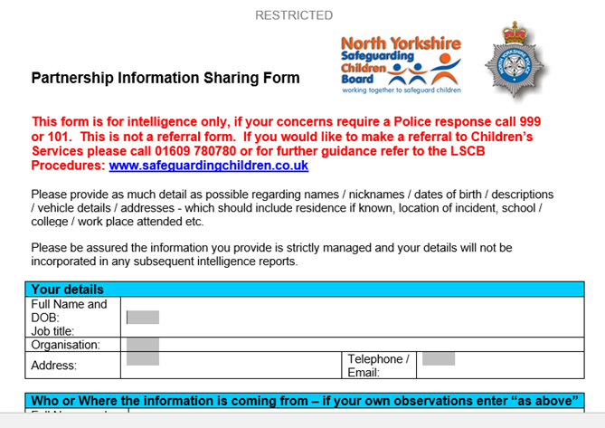
Partnership Intel Sharing Form
https://www.safeguardingchildren.co.uk/professionals/forms-for-professionals/

Slide 63
Challenges and Opportunities
Affluent rurality
  Isolation
  Parents/Guardians work long hours
  Access to latest technology
Hard to reach groups
  Same sex abuse/exploitation/female perpetrators
  Cultural silence
It doesn’t happen here
Opportunity for prevention
  Key messages
  Wider safeguarding opportunities
  Challenge practice
Raise awareness within communities
  Spotting the ‘unusual’ cuckooing
Recognise our own bias's/preconceptions
Challenge pre-conceptions
  Understand our communities

Slide 64
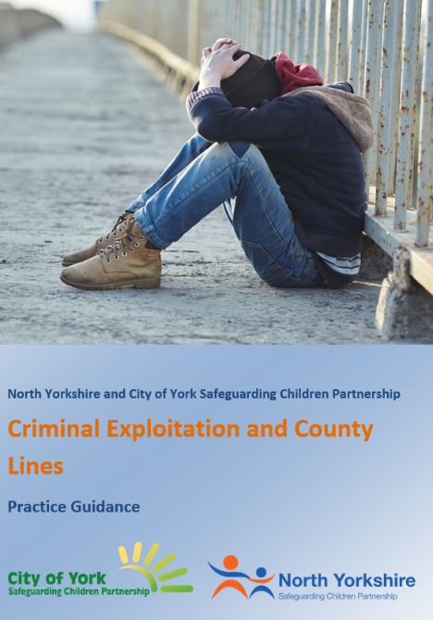
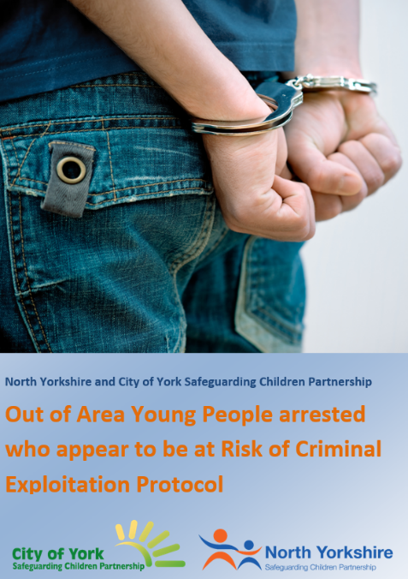

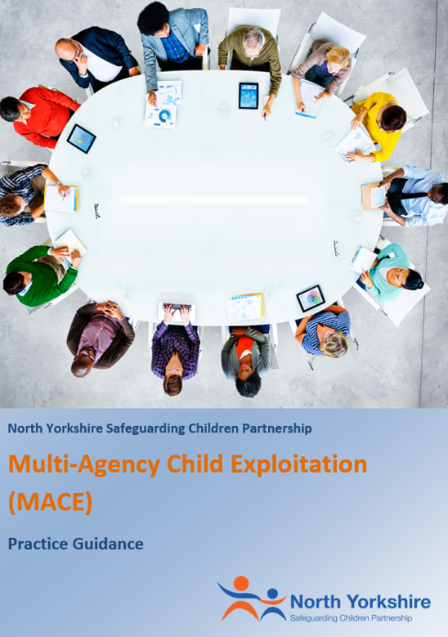

Practice Guidance for Professionals
www.safeguardingchildren.co.uk
Notes:
The North Yorkshire Safeguarding Partnership have developed a number of practice guidance documents to help practitioners with what to do if they suspect a child is being exploited.
Both the Child Exploitation and County Lines practice guidance and the Out of Area young people arrested who appear to be at risk of criminal exploitation protocol are joint between North Yorkshire and City of York to ensure that we are joined up in our approach. There is now the new MACE practice guidance which is an overview for the MACE and Contextual Safeguarding process. We also have a one minute guide that will be sent out across the partnership that offers quick time overview of the processes.

Slide 65
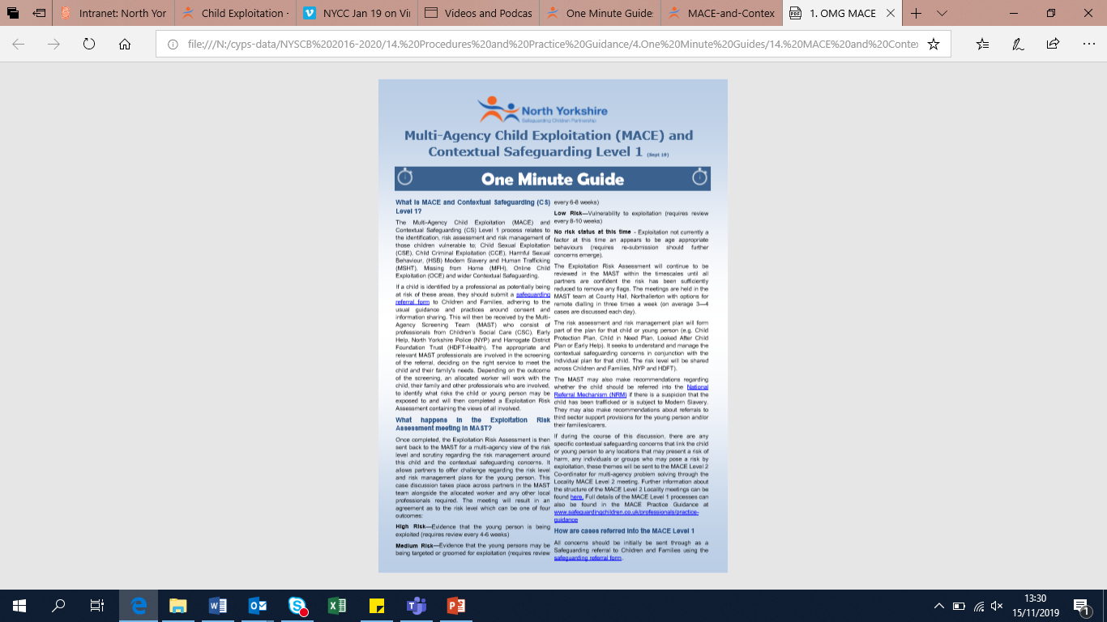
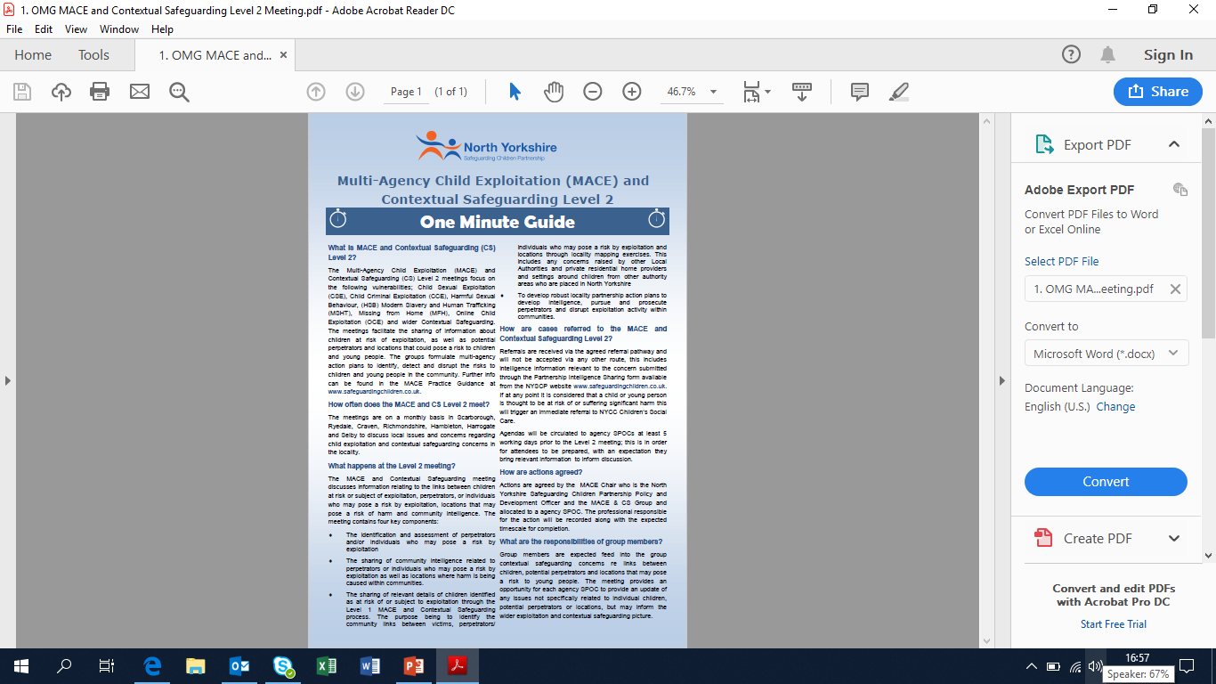
One Minute Guides and Useful Links
www.safeguardingchildren.co.uk/resources
www.contextualsafeguarding.org.uk
www.nwgnetwork.org
https://www.net-aware.org.uk/
www.internetmatters.org
https://www.childrenssociety.org.uk/what-we-do/our-work/tackling-criminal-exploitation-and-county-lines/county-lines-resources
Notes:
We have a quick One Minute Guide to MACE that can be shared across the partnership to team. This can be accessed through our Safeguarding Children Partnership Website at www.safeguardingchildren.co.uk/resources

Slide 66
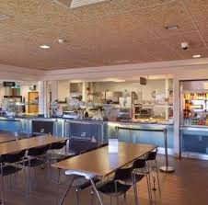
Scenario One
You are working in a school and note that Tom has recently become very quiet. He doesn’t have a strong friendship group, but has recently been seen at break times and lunchtimes with other pupils who are known to present challenging behaviours in school and in the community. A couple of staff in school have said they weren’t aware that he was friends with a different group and there are concerns at who he has been hanging about with at break times. Tom has talked to you about not being liked and not having real friends.
You notice that Tom has got new items e.g. new phone, new pencil case, new jacket etc. When asked, Tom had stated Tom is referring to is an adult and known in the community for criminal behaviour etc.

Slide 67

Scenario Two
You are working in a GP surgery and a 13 year old girl attends drop in clinic wanting the morning after pill. She attends with an adult who appears very supportive and concerned about the girl’s welfare. You believe that she is the child’s older sister. The child appears to be very concerned her parents don’t find out she is there and appears reluctant to disclose who she has had sex with

Slide 68

Scenario 3
14 year old girl who presented to the Minor Injuries Unit with a knife wound to her thigh. She stated that this was an accidental injury caused by her dropping a knife whilst cooking. The wound required suturing, but otherwise she appears fit and well. She discloses she is a regular cannabis user, but did not appear under the influence at the time. She was accompanied to the Unit by an older man, who looked to be about 20/21 years old. The adult male stated that she was his friend and she was staying with him for a few days as she lived out of this area.
During the consultation you notice she has two mobile phones, one of which continually received messages. You also note she was very quiet and the older adult male does most of the talking.

Slide 69
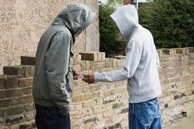
Scenario 4
You are working as local Police and Community Support Officer and are asked to have a chat with a 15 year old boy who you know frequently runs away from home, however due to neglect within the household, many of these missing episodes go unreported to police and social care. His school attendance has recently deteriorated and is no longer in main stream education. You know he has been involved with the police for minor crimes. He mentions that he has recently been to ‘Doncaster’ and was picked up by ‘the Feds’ and searched for drugs. He claims they had nothing on him as his ‘crew’ have his back and he now carries a lock knife for protection.

Slide 70
Scenario 5
You are working with a young 16 year old male and the conversation turns to relationships. He states that he thinks people over react to nudes and states its just a bit of fun and that everyone does it. He states that he often dms d**k pics (pictures of a penis) to 10 girls on his Instagram.

Slide 71

Where next?

Slide 72
Any Questions?
If there are an questions or you would like to be invited to a MACE meeting, please don’t hesitate to get in touch:
Emma Phillips,
NYSCP Policy and Development Officer,
Emma.Phillips@northyorks.gov.uk

Slide 73


Substance misuse in North Yorkshire

Slide 74

Compass REACH
Specialist Substance Misuse Service
Early Help and Prevention Emotional Wellbeing and Mental Health
Universal Sexual Health Support
Commissioned to work with 9-19 year olds (up to 25 if SEN)
Consent based help and support
Confidential service within the bounds of child safeguarding and risk management.
Structure of our team:
Service Manager, Nurse Team Leader & Administrator
8Fte Nurses/Practitioners across North Yorks

Slide 75
What we offer
Specialist harm reduction interventions, e.g. harm minimisation, sexual coercion and exploitation, overdose prevention, blood borne virus (BBV) screening and vaccinations, safe self harm.
Age appropriate specialist information and advice, e.g. contraception and STI screening, sexual health and substance misuse advice.
Structured and pre-planned support for young people experiencing emotional wellbeing and mental health difficulties at an early help and prevention level including BSFT, CBT, MI and BA.
Risk reduction and life skills interventions, e.g. communication, decision making, consequential thinking, coping strategies and self management skills, and relapse prevention.

Slide 76
What we offer
Psychosocial and behavioural change models e.g. Cognitive Behavioural Therapy, Brief Solution Focused Therapy, Motivational Interviewing, Behavioural Activation.
Direct 1 to 1 support e.g. holistic assessment, collaborative care plan and timely discharge planning with onward referrals.
“helping people unleash their unique potential and
live healthier, safer and more fulfilling lives.”

Slide 77
Activity 1. (2 mins)
Ask the person nearest to you:
What do you know about drugs and alcohol already? Locally and Nationally?
How would you support someone who needs help with substance misuse?
(No using phones to find answers!)

Slide 78
Drugs and alcohol 101.
Majority of work delivered is around affecting motivation, change, and reducing harm
Majority of referrals are for cannabis use
Alcohol and drug misuse often multi-factoral
Safeguarding procedures of paramount importance with risky substance misuse
Mindset of “Making every contact count”
A need to address all aspects of life and health care needs

Slide 79
National picture - habits
10% of pupils stated using substances in last month (11-15 yrs)
Cannabis remains most common drug used (11-15)
Higher rates of drinking and drug use compared to other European Countries (11-15)
Permanent exclusions for alcohol or drug use have risen from 330 to 565 from 2011/12 to 2016/17
There is an upward trend in the use of Class A drugs among 16 to 24 year olds since 2007/08 to 2017/18
Illicit drug use was 3 times more likely in 11 to 16 year olds with a mental disorder (13.9%) than in those without one (4.1%).
66% of Young People in Specialist services were male
Number of under 14’s in specialist treatment has increased from 2016/17 to 2017/18 by 6%
Smoking, Drinking and Drug Use Among Young People in England 2016: Pupils aged 11-16.
Alcohol and Drug Treatment for Young People: stats summary 2017 to 2018

Slide 80
National picture – substances
Cannabis (88%), Alcohol (46%), Ecstasy (14%), Cocaine (10%), Solvents and Benzos (both 2%) substance use of young people in treatment services.
Measuring of young people’s vulnerabilities – Early onset of SM (77%), Poly-use (57% - more likely in females), ASB or crime (32%), Mental Health needs (27%) and Affected by domestic violence (19%).
22% reported being affected by another's substance misuse
Substance misuse and links to CSE and CCE increasing
81% of Young People discharged from Specialist services within 12 weeks with a successful discharge
15,583 young people in specialist substance misuse services in 2017/18. This is a 35% decrease since 2008-09
Smoking, Drinking and Drug Use Among Young People in England 2016: Pupils aged 11-16.
Alcohol and Drug Treatment for Young People: stats summary 2017 to 2018

Slide 81
Local picture
4% of Year 6 pupils report to have tried e-cig’s
31% of Yr 10 and 20% of year 8 pupils responded that they have been offered cannabis
46% of Yr 10 pupils have reported to have tried drugs and alcohol on the same occasion
No age group reported over 48% when asked if they found school lessons on substance use ‘quite useful’.
4% of Year 8 pupils reported being offered cannabis or other drugs while ‘hanging about outside’
1/3 of 6th Form students asked had taken drugs
38 arrests made in NY for under 16’s with intent to supply in 2015
(2018 Growing Up in North Yorkshire report) and
North Yorkshire Police F.O.I. request on arrests of under 16’s.

Slide 82
Service Specific & Reflections
Similarities to national picture
Increase in poly-drug use, specifically involving MDMA and Xanax
Increase in co-morbidity of drug use and mental health issues
Increasing trend in substance use linked to CCE and CSE
2019 – Primary Drug Issue – Compass REACH
83% Cannabis
9.3% Alcohol – Nationally 46% for YP in treatment support.
2% MDMA/Ecstacy – rose to 8% when added with secondary and tertiary drug issues

Slide 83
What does this mean for us all?
Being more aware and informed about current drug and alcohol trends
Being professionally curious in particular where there are obvious vulnerabilities
Using this information to inform YP in NY about norms and dispelling myths
Better understanding the local needs of young people in substance misuse services

Slide 84
Policy and strategy context
Drug Strategy 2017:
  Reducing demand - Identifying vulnerable groups, monitoring and early action on evolving and emerging threats
  Restricting Supply – Managing information and intelligence, monitoring and taking action on ‘enablers of criminality’ e.g. internet, crime and exploitation
  Building Recovery – Effective treatment and support systems
  Global action – Shaping more effective policy and practice
Alcohol Strategy 2012:
  Made suggestions of minimum unit pricing (not currently imposed in England) – issues with cheap alcohol
  Other issues: Advertising, Increasing liver damage in YP, reducing harms to YP, and supporting “Health campaigns”.
Drug Strategy 2017 & Alcohol Strategy (2012)

Slide 85
Policy and strategy context
Working together to safeguard children 2018
  Gather information about the child and family
  Analyse needs/level of risk
  Does the risk warrant CSC referral/support in line with section 17 or section 47 of the Children’s Act and/or Specialist Substance Service
  A need for good quality referrals to ensure accurate and appropriate information sharing to help safeguard young person
Misuse of Drugs Act 1971
  Imposes law on illicit substances deemed harmful or dangerous
  Offers some structure to understanding some of the level of harms and risks involved with substance use
Misuse of Drugs Act 1971 & Psychoactive Substances Act 2016
Working together to safeguard children 2018

Slide 86
Some good news…
**Most young people don’t use drugs**
(The majority of those who do, are recreational users)
Some useful information to take away…
Think about how you may use this information and how it might help you when working with young people?

Slide 87
Ecstasy and MDMA
Often regarded as a party drug, but more frequently being used in other settings
Ecstasy or E’s come in pill form, but when in powder referred to chemical name MDMA (methylenedioxy-methylamphetamine)
Stimulants, causing feelings of euphoria and extremely energised, often feeling ‘loved up’
A recent increase in potency / effect, similar to cannabis todays pills/MDMA appears to be of stronger potency (upto 3 times as potent)
Cost around £5-10 per pill
Often pills are made to look ‘cool’ and often have nicknames depending on their design e.g. superman, soundcloud
In 1993 there were 12 reported deaths nationally, in 2015 there were 57.

Slide 88
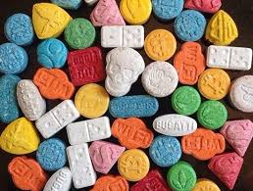

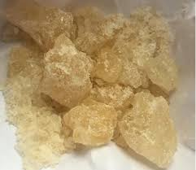
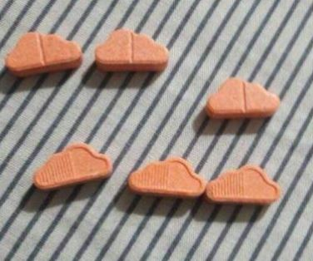
Ecstasy and MDMA
What E’s and MDMA looks like/methods of use:
Street names:
E’s, Mandy, Molly, Superman, Pills, Beans, MDMA, Crystal, MD

Slide 89
Ecstasy and MDMA
Main concerns in relation to Ecstasy and MDMA:
Increased risk of heart attack and stokes
Over-hydration leading to swelling of cells and brain damage/death
Continued use linked to liver, kidney and heart problems
Epilepsy and seizures
Increased risks of depression and anxiety
Overdose
Side effects unknown due to being cut with other substances

Slide 90
General Harm Reduction Advice:
Use little and slowly, wait for effect, don’t re-dose too soon
Never use alone
Never mix with other substances
Stay hydrated – not over-hydrated (sips regularly 500mls per hour – Isotonic drinks are advised)
Seek medical advice for adverse reactions
Offer reassurance and support during episodes of anxiety
Know how to perform CPR and dial 999 in an emergency – “Lifesaver App”
Use drug testing kits if possible to keep yourself safe (Festivals and personal)

Slide 91
Referrals
Compass will accept a referral from any source as long as the young person has consented to the referral being made i.e. Professionals, Schools, Parents or self referrals from young people. You can email or post referrals to us.
Compass will contact the referrer to confirm receipt of referral and inform you of what will happen next.
If Compass receives an inappropriate referral then we will advise the referrer as to what to do and ensure they receive adequate support and guidance.
We will endeavour to get informed consent from the young person so that the referrer can remain involved in the young person treatment/care plan.
Compass will inform you of whether the young person has engaged with the service (subject to consent).

Slide 92
Compass REACH
County Hall
1 Racecourse Lane
Northallerton
DL7 8AD
Office: 01609 777662
Freephone: 0800 008 7452
Email: NYRBS@compass-uk.org
Compass Service Manager: Lisa Gale

Slide 93
Links and References
https://assets.publishing.service.gov.uk/government/uploads/system/uploads/attachment_data/file/762446/YPStatisticsFromNDTMS2017to2018.pdf
https://digital.nhs.uk/data-and-information/publications/statistical/smoking-drinking-and-drug-use-among-young-people-in-england/2016
https://assets.publishing.service.gov.uk/government/uploads/system/uploads/attachment_data/file/729249/drug-misuse-2018-hosb1418.pdf
https://digital.nhs.uk/data-and-information/publications/statistical/mental-health-of-children-and-young-people-in-england/2017/2017
https://northyorkshire.police.uk/access-to-information/foi-disclosure-log/16-arrests-drugs-possession-2015-2016-831-2016-17/
https://cyps.northyorks.gov.uk/sites/default/files/Childrens%20voice/GUNY/NYork2018summary_SCREEN.pdf

Slide 94
NYSCP Round Up

Slide 95
Multi-agency Audit Findings
Child Exploitation Multi-Agency Audit (July 2019)
School Safeguarding Audit 2018/19 (September 2019)

Slide 96
Child Exploitation Multi-Agency Audit
Learning Summary
Areas for Development
- The quality of impact in reducing & stopping the exploitation was limited
- Absence of a coordinated response in disrupting the perpetrator
Good Practice
- Recognition & Assessment of CE was generally good. The NY specific CE assessment is a positive development
- Some examples of planning & intervention around yp’s risks to exploitation was exceptional
- Level of joint working was generally high, the development of MACE came through strongly
What’s has happened since?
- The report is being finalised and the action plan will be adopted by the Learning & Improvement Subgroup
- Agencies will consider the report and implement recommendations specific to their service area
- Once finalised, the report will be available to access here
Issues and/or Actions for Practitioners
- Services working across a case agreeing whether a young person was a victim or committing offences of their own violation
- Frontline 0-19 HDFT & Voluntary Agency staff did not always have sight of a young person’s child exploitation risk assessment
Notes:
Good Practice
Recognition & Assessment: Recognition of CE was good, services identified the vulnerabilities & risk factors well. However the recognition within the cases seemed to be identified once a referral had come through MAST. There were instances where schools had submitted an initial referral for support without CE being identified as a concern. The referral for support to MAST and child exploitation was not identified as being a concern. It may well be that during this period when a referral was submitted CE was not a worry, but in both instances CE was identified promptly by those services who received the referral for support.
Assessment was generally robust and dynamic in relation to a yp’s risk in relation to CE. The introduction of a North Yorkshire specific child exploitation risk assessment is a positive development and enables professionals to capture the risk more accurately within a multi-agency approach and identify actions to take forward as a result of the risk assessment.
Planning & Intervention: Given the complexity in the cases, the tenacity and relationship frontline workers demonstrated with the young person was outstanding. There was one instance of a creative intervention planned and delivered by services in partnership to mitigate the difficulty in engaging a young person on a 1-2-1 basis. Services who were involved in the case delivered targeted group provision to the young person and their peer group in the community, which resulted in increased engagement and awareness raising of the risks associated with going missing. This piece of work highlighted the value of services having the capacity to deliver contextual safeguarding.
Joint Working: In a number of instances, the ability for a MACE locality group to action specific mapping exercises for young people and perpetrators to focus on how to contextually safeguard a young person and their peer group is a creative approach in partners being able to work together locally. Particularly of note, was the involvement of housing providers and education in the mapping exercises in the cases presented, as this provided important information which has traditionally been absent. The emphasis too, in looking to ensure ongoing support for a vulnerable young person who is on the cusp of becoming 18 through working with adult services via MACE again was highlighted as good practice.
Areas of Development
Impact & Absence of Disruption: The absence of a coordinated response in disrupting the perpetrator where exploitation was taking place or suspected made it incredibly challenging to evidence there had been a reduction to the risk of exploitation or stopping the exploitation as a whole. This demonstrated the extent of how much of a manipulating force a perpetrator can be. In one case, through work carried out by the Social Worker, the young person had recognised what was happening to them as exploitation. However, the young person still felt unable to escape from this.
Issues
Agreement of CE risk status: The ambiguity and inconsistency from services in one case in recognising and agreeing whether the young person was a victim or committing offences of their own violation hamstrung the ability to provide appropriate support and intervention
CE Risk Assessment: HDFT initially raised a concern that staff were not receiving copies of completed child exploitation risk assessment for young people who are open to the 0-19 service. However, HDFT do have access to the tools in MAST. An action was set for HDFT to explore how they can upload the risk assessment onto system one so frontline workers have sight of these.
Voluntary agencies such as PACE & Hand in Hand were relatively new services in North Yorkshire within the timeframe of the case chronologies and as such information sharing was not as well established with partner agencies then as it is now. This has been improved through MACE.
What’s Happened Since?
The report is being finalised and the action plan will be adopted by the Learning & Improvement Subgroup
Agencies will consider the report and implement recommendations specific to their service area
Once finalised, the report will be available to access here

Slide 97
School Safeguarding Audit 18/19
Learning Summary
What’s happened since?
- Headteachers should use results of their audits as part of their development plan
- A detailed report & presentation is available here
- Audit tool will be reviewed
- Next audit will commence in Nov 2020 and all schools to respond in Mar 2021
Issues for Schools
- Training around specific topics such as Criminal Exploitation & County Lines
Areas for Development
- Limited number of schools not keeping register of cases escalated to DSL and/or not maintaining a welfare file on CYP open to services
- Managing Emergency Situations
- Schools having arrangements in place for LAC
- Independent schools reporting hate crimes via technology to the LA
Good Practice
- Strong majority of schools have expected safeguarding controls in place
- Improvement to Single Central Record from 2016/17
- E-safety controls well addressed in most schools
- RSE policy either fully implemented or actions in place for most schools
Notes:
Good Practice
Record Keeping: General record keeping, particularly the requirement in relation to Single Central Record has seen improved compliance since 2016/17, although particular controls in instances again have been identified as an issue across all schools.
E-safety: E-safety controls are well addressed in many schools and this is testament to the work schools and NYCC Education & Skills have carried out since the 2016/17 audit cycle.
RSE: Most schools either have Relationships and Sex Education policy fully implemented or have identified actions in place to address this ahead the new curriculum being mandatory for Sep 2020. However, there were a small number of primary schools (12 schools) who either reported this control as a concern without an action in place to address, as an unidentified concern, not applicable or did not provide an answer.
Areas of Development
Record Keeping: There appears to remain some concern that a limited number of schools did not keep a register of cases escalated to the DSL which would indicate that these schools could not appropriately monitor concerns or patterns of behaviour. Further, a minority schools reported that it was not applicable to maintain a welfare file for all children known to CSC, LAC, in receipt of Early Help support or for whom there are welfare concerns, again raising questions as to how those schools monitor progress, or concerns and patterns of behaviour.
Emergency Situations: This safeguarding control sought the least responses of the control being fully implemented and the most concerns without a current action plan in place and previously unidentified concerns. Most schools who identified this control as a concern, referenced the need to review their procedures in line with the Run, Hide and Tell Guidance and Action Counter Terrorism (ACT) Awareness Training. This guidance and training can be accessed within the School Sample Child Protection Policy 2019-20.
LAC: Schools responses to having arrangements in place for LAC and previously LAC was an area which did not receive the level of compliance that would be expected. Across each establishment, barring maintained secondary schools, there were a number of schools who either reported they did not have an action in place to address the requirement, the control was previously unidentified, or noted to be not applicable.
E-safety: There does still remain some areas for development for some schools in relation to e-safety, most notably for Independent Schools to ensure they report incidents which take place via technology such as hate crime, bullying, harassment or extremist behaviour are reported to the Local Authority.
Issues
Schools identified particular training needs where they did not know how to access the training, most notably in accessing Criminal Exploitation & County Lines training.
What’s Happened Since?
NYSCP: NYSCP has produced a detailed School Safeguarding Audit report and presented this to the NYSCP Learning & Improvement Subgroup (LIS). The recommendations detailed within the report have been adopted onto an action plan to support schools where areas of development have been identified. In addition the findings of the audit have been presented at the Headteacher and DSL Network and NYSCP Education Focus Group meetings. The report and presentation can be found here.
All Headteachers and Governing Bodies should take note of the thematic findings and use the results of their audits to identify areas for improvement and this should be included as part of the school development plan.
The NYSCP audit tool will be reviewed and updated taking into account the feedback received from schools who were asked after completing the exercise, to complete a short survey based on their experiences of the audit. The next School Safeguarding Audit will commence in November 2020 and all schools will be required to respond by the end of March 2021.

Slide 98
Drug Early Warning and Alert Protocol
Co-ordinated approach to communication of valid drug/ substance related threats that are or may be applicable in North Yorkshire
Aim: to reduce the risk of potential harm or death related to drug misuse
What should be reported:
Purity/contamination of illicit drug supplies in circulation;
New psychoactive substances (also known as NPS or legal highs);
Diverted prescribed medications;
Drugs recently seized by North Yorkshire Police;
Health protection alerts related to substance misuse;
Overdose or death related to drug misuse – if sufficient evidence to indicate broader public health harm
Notes:
In the current day there is lots of information in the media related to drugs and it can be quite difficult to ascertain which ones are relevant or factual. The purpose of the Drug Early Alert Protocol is to inform people who use drugs of an immediate risk and allow professionals to make informed decisions.
Because this covers lots of services, the protocol is hosted by Public Health who receive intelligence the facts. It’s important to note that Public Health will do the checking, facilitation and issue the alert, but this is not a Public Health Protocol. It is a system-wide protocol and that’s why we need everyone’s help to raise awareness so we have a consistent response and approach across the county. The idea that we only issue one alert to all and don’t have lots of duplicated emails with information.
So we would ask if you think you have any information which fits the criteria on the slide that this is forwarded on using the contact details on the next slide.

Slide 99
How to report and what happens next
Notify the co-ordinator within the Public Health Team:
nypublichealth@northyorks.gov.uk
Telephone: 01609 536962
2. Assist with completion of the Drug Alert Intelligence Form
3. Report to other organisations as applicable – e.g. North Yorkshire Police, Controlled Drugs Accountable Officer Important: This does not replace responsibility for reporting illicit activity to North Yorkshire Police via 999, 101 or Partnership Intelligence Form to Intelligenceunit@northyorkshire.pnn.police.uk
4. Public Health Co-ordinator will corroborate with partners and a decision will be made about whether to issue an Alert
5. If Drug Alert is issued it will be sent to agreed distribution members
Notes:
Once we receive this information we may ask you some additional questions like if the person(s) were admitted to hospital, what type of reaction they had, when and where it happened, what the substance looked like. This will help us to build up a picture of the professionals we need to co-ordinate across the public protection sector to triangulate different reports and establish what we know.
To note, this operates alongside the Police Intelligence process so information should be shared to both sources (detail in red on slide 2).
Feeding information into the process will allow us to build up a picture very quickly and work out if this is a local issue or county-wide. It will reduce duplication of information across the system. We will only issue alerts where necessary. The number of alerts we issue varies, but typically can be around 5 a year including some national ones. We will then distribute the alert as appropriate to hospitals, different sections of the council, police, neighbourhood teams, safety partnerships to name a few. In CYP this will go to Directors for them to decide how to proceed and cascade.

Slide 100
Local Safeguarding Partnerships (LSPs)
LSPs are local safeguarding meetings where partners come together across children & adult services to identify the safeguarding need of areas and look to address this need through partnership working
The meetings have just launched recently and run on a quarterly basis in:
  Harrogate & Craven
  Scarborough, Whitby & Ryedale
  Hambleton & Richmondshire
  Selby
Given that the LSPs are in their infancy, each group is looking to broaden membership, particularly amongst early years and education settings

Slide 101

Private Fostering
Notes:
Private fostering is under reported nationally and we too in North Yorkshire only have a handful of young people recognised as being Privately Fostered.
In short, PF is when a young person is being cared for by an adult who is not their parent or a close relative and the arrangement lasts for more than 28 consecutive days.
In partnership with NYCC C&F we will be running a host of awareness raising campaigns to make professionals aware of what PF is and their statutory duty.

Slide 102
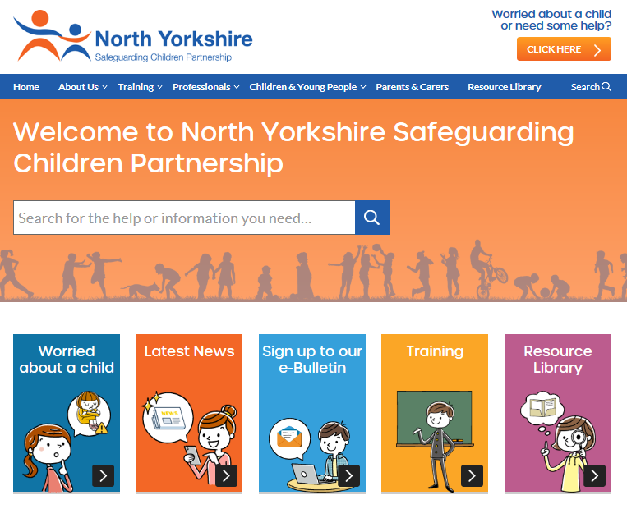
www.safeguardingchildren.co.uk

Slide 103

Updated Procedures, Practice Guidance, One Minute Guides
Procedures / Practice Guidance / One Minute Guides can be downloaded here:
https://www.safeguardingchildren.co.uk/professionals/

Slide 104

Training Offer…
NYCC Safeguarding Children Basic Awareness - Online Learning
Home Office E-Learning Training on Prevent
NYCC Comprehensive Child Protection Pathways (CCPP)
NYCC Comprehensive Child Protection Pathways (CCPP) Refresher
NYCC Safeguarding Children
NYCC Young People and Risky Behaviour
NYCC Child Sexual Exploitation: Working with those directly at risk of CSE
NYSCB Developments in Safeguarding Manager’s Masterclass
NYSCB Managing Allegations Against Staff
NSPCC Managing Sexualised Behaviour In Schools: online courses
Child Death Reviews: Advanced Training for Rapid Response Teams
Forced Marriage
Female Genital Mutilation (FGM)
Domestic Abuse Awareness Training
Hate Crime Signposting in North Yorkshire
Zero Suicide Alliance e-training
Health Education England Suicide Prevention e-learning
safeTALK Suicide Alterness Course (Available to workers in the Harrogate District)
Full details: http://www.safeguardingchildren.co.uk/learning-improvement/training-courses

Slide 105

www.twitter.com/nyscp1

Slide 106
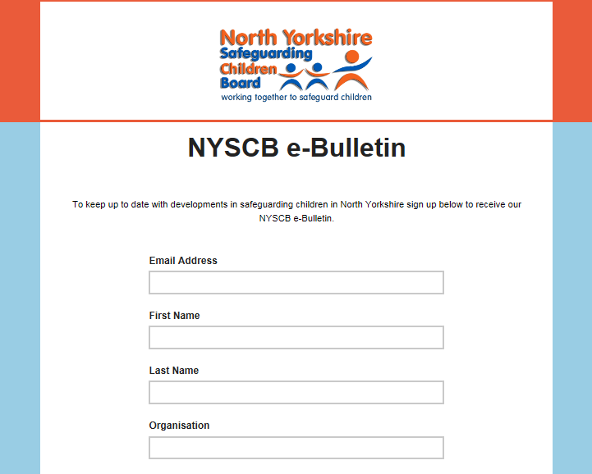
NYSCP e-Bulletin
Free NYSCP Monthly e-Bulletin Sign Up here

Slide 107
Any Questions?
Thank you for attending …
Have a safe journey

Slide 108
Contact Us..
James Parkes,
NYSCP Partnership Manager,
James.parkes@northyorks.gov.uk
Emma Phillips,
NYSCP Policy and Development Officer (MACE),
emma.phillips@northyorks.gov.uk
Jonathan Giordano,
NYSCP Policy and Development Officer,
jonathan.giordano@northyorks.gov.uk
General enquiries: nyscp@northyorks.gov.uk
General phone number: 01609 535123
Website: www.safeguardingchildren.co.uk

