Slide 1

Safeguarding
COVID -19

Slide 2
Purpose
This presentation is to support Designated Safeguarding Leads (DSLs) in the wider opening of North Yorkshire schools
It includes
  Updates from DfE Safeguarding Guidance
  Emerging Issues during Covid-19
  National and Local Guidance and Support

Slide 3

Keeping Children Safe in Education 2020
The DfE have suspended the consultation on their proposed amendments to Keeping Children Safe in Education due to the impact of the COVID-19 virus
The NYSCP Autumn term refresh of the sample Child Protection Policy for schools and the NYSP Safeguarding Audit for Schools will take into account any Keeping Children Safe in Education 2020 published changes
https://consult.education.gov.uk/safeguarding-in-schools-team/keeping-children-safe-in-education-2020/

Slide 4
Most recent DFE Safeguarding guidance update
DFE Guidance Coronavirus (Covid-19): safeguarding in schools, colleges and other providers
Updated 20th May, 2020

Slide 5

DfE Safeguarding guidance update
20th May 2020
child protection policy will need further review and update
designated safeguarding lead arrangements on phased return
protecting vulnerable children and mental health.

Slide 6

DfE Safeguarding guidance update
20th May 2020
‘As more children return, a number of important safeguarding principles remain the same:
  the best interests of children must always continue to come first
  if anyone in a school or college has a safeguarding concern about any child they should continue to act and act immediately
  a DSL or deputy should be available
  it is essential that unsuitable people are not allowed to enter the children’s workforce and/or gain access to children
  children should continue to be protected when they are online’

Slide 7
DfE Safeguarding guidance update
20th May 2020
Trained DSL (or deputy) available on site – exceptional circumstances other arrangements to be made and role of on site senior leader clear
Contact maintained with children (and their families) who are not yet returning to school
DSL training is unlikely to take place during this period (although the option of online training can be explored). For the period coronavirus measures are in place, a DSL (or deputy) who has been trained will continue to be classed as a trained DSL (or deputy) even if they miss their refresher training
Continue to do what they reasonably can to keep up to date with safeguarding developments
Where reasonably possible and where relevant, the DSL (or deputy) should consider these challenges in a child protection context and reflect them in the child protection policy as appropriate.
DSLs

Slide 8
DfE Safeguarding guidance update
20th May 2020
Local authorities have the key day-to-day responsibility for delivery of children’s social care
Social workers and virtual school heads will continue to work with vulnerable children in this difficult period.
School and college staff (supported by the DSL or deputy) should continue to work with and support children’s social workers, virtual school heads and any other relevant safeguarding and welfare partners to help protect vulnerable children
See later slides Vulnerable Pupils
Vulnerable Pupils

Slide 9
DfE Safeguarding guidance update
20th May 2020
Negative experiences and distressing life events, such as the current circumstances, can affect the mental health of children and their parents.
Where schools have children of critical workers and vulnerable children on site, and/or more children returning to school from 1 June onwards, schools and colleges should ensure appropriate support is in place for them.
DfE Guidance Mental health and behaviour in schools
Support for pupils and students in the current circumstances can include existing provision in the school or college (although this may be delivered in different ways, for example over the phone for those children still not attending provision) or from specialist staff or support services.
Teachers should be aware of the impact the current circumstances can have on the mental health of those students/pupils (and their parents) who are continuing to work from home, including when setting expectations of childrens’ work
See later slide LA Wellbeing Guidance
Mental Health

Slide 10
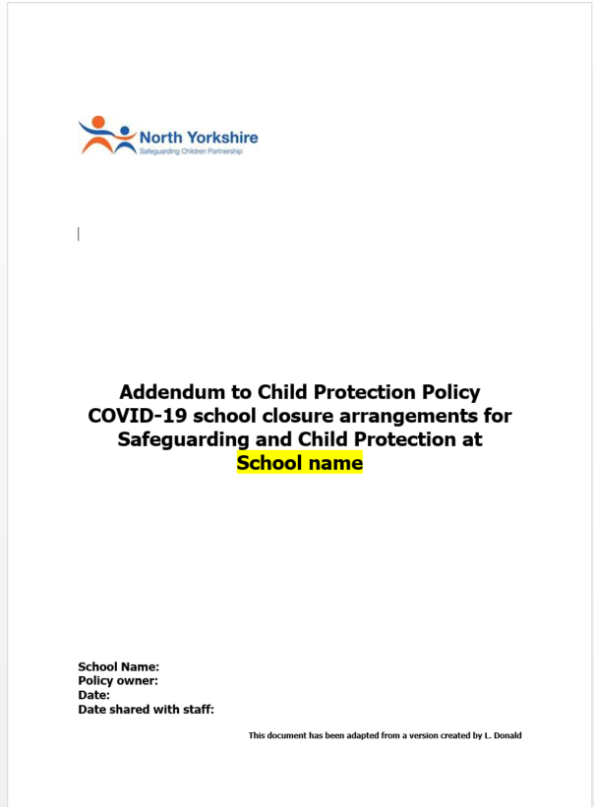
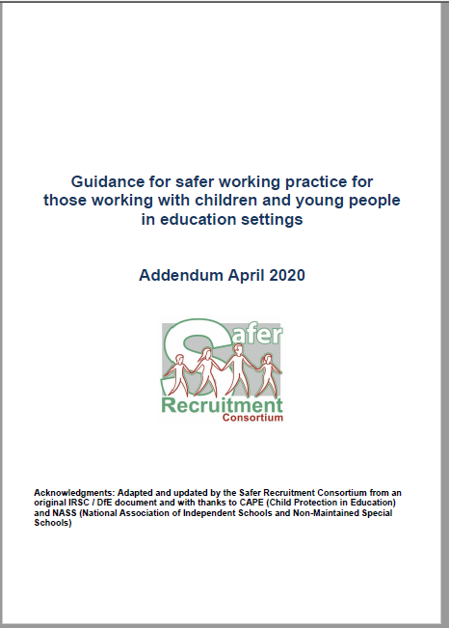
Key Policy Updates
Have governors agreed and do staff and volunteers know and understand Covid-19 policy and procedures?
  Child Protection Policy Addendums
  Safer Working Practice Addendum
  https://cyps.northyorks.gov.uk/covid-19

Slide 11
DfE Safeguarding guidance update
20th May 2020 Child Protection Policy Addendums- to be shared with staff and volunteers and made publically available
May 2020 The planned return of more children is an appropriate time to consider a further review - with annex or addendum to policy which may include:
New safeguarding concerns on return and referrals
DSLs and deputies more time to support staff/children
Communications with parents/carers on any welfare/health and wellbeing changes prior to return
Keeping children not physically attending school safe
Approach to protecting vulnerable children
Updated advice
  safeguarding partnership local arrangements
  local authorities regarding children with education, health and care (EHC) plans
  the local authority designated officer
  children’s social care, reporting mechanisms, referral thresholds and children in need
Ongoing work with children’s social workers, the local authority virtual school head for looked-after and previously looked-after children and any other relevant safeguarding and welfare partners
Child Protection Policies

Slide 12
Key Focus Areas
Previous Child Protection Policy Addendum
March 2020
Vulnerable pupils and attendance monitoring
Access to Designated Safeguarding Lead
Reporting concerns when on/off site
Safer recruitment – minimising face to face contact
Children and online safety away from school and college
Support for children not in school/in school
Peer on peer abuse
NB sample Child Protection Policy Addendum uploaded to https://cyps.northyorks.gov.uk/covid-19

Slide 13

Key Focus Areas
Safer Working Practice Addendum
Use of technology for online/virtual learning
  Reviewing online and acceptable use policies
  Standards of conduct
  Operating times
  Alternatives- e.g. using audio only, pre-recorded lessons, existing online resources
  Avoiding one to one situations
  Clarity on recording lessons/online meetings
  Use of pupil images in staff possession
Appropriate professional boundaries - remote contact
Clothing as worn on normal school day when online
Updating care plans/intimate care for temporary staff
Working one to one only when necessary and with knowledge of senior leaders/parent/carers
Guidance on essential home visits
First aid and medication

Slide 14

Behaviour Policy
Your behaviour policy should be updated to reflect the new rules and routines necessary to reduce risk in your setting
Agree how to communicate this to school staff, pupils and parents
DfE Guidance: Opening schools for more children and young people: initial planning framework for schools in England

Slide 15

Behaviour Policy – areas to consider (primary)
following any altered routines for arrival or departure
following school instructions on hygiene, such as handwashing and sanitising
following instructions on who pupils can socialise with at school
moving around the school as per specific instructions (for example, one-way systems, out of bounds areas, queuing)
expectations about sneezing, coughing, tissues and disposal (‘catch it, bin it, kill it’) and avoiding touching your mouth, nose and eyes with hands
tell an adult if you are experiencing symptoms of coronavirus
rules about sharing any equipment or other items including drinking bottles
amended expectations about breaks or play times, including where children may or may not play
use of toilets
clear rules about coughing or spitting at or towards any other person
clear rules for pupils at home about conduct in relation to remote education
rewards and sanction system where appropriate
Identify any reasonable adjustments that need to be made for students with more challenging behaviour.
Ref:
DfE Preparing for the wider opening of schools from 1st June: A planning guide for primary school leaders to help prepare them to open schools for more pupils during the coronavirus outbreak

Slide 16
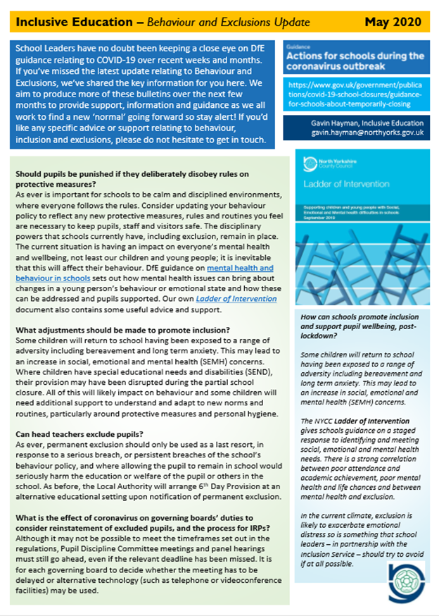
Supporting guidance
There will be further guidance from the NYCC Inclusion team through the Inclusion bulletins which will be forwarded to schools in the e-red bag and uploaded onto https://cyps.northyorks.gov.uk/covid-19

Slide 17

Vulnerable Pupils including our pupils with EHCPs
Are our risk assessments for our vulnerable and EHCP children being regularly reviewed (at least fortnightly)?
What reasonable endeavours are we applying to continue provision for EHCP children whether at home or at school?
Are risk based decisions and attendance plans being reviewed regularly (every 2-4 weeks) for vulnerable pupils with social care contact?
Are transition arrangements in place for pupils with EHCPs?

Slide 18
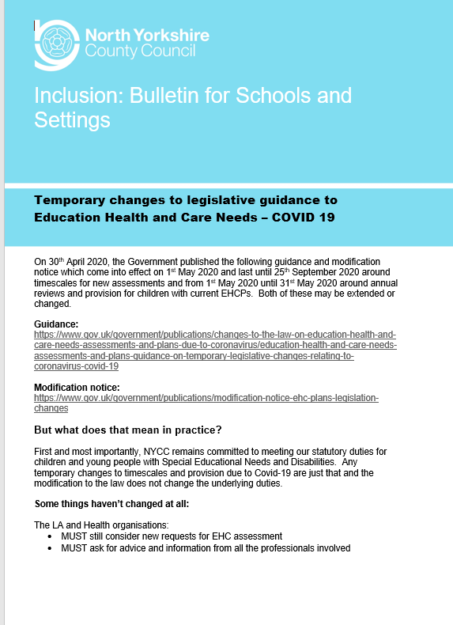
Temporary modifications to the law for EHCPs
Any temporary changes to timescales and provision due to Covid-19 are just that and the modification to the law does not change the underlying duties.
Annual reviews should still go ahead, although they may need to happen remotely / virtually. They may need to be shorter and the paperwork and reports may be simplified.
Schools / settings and parents can still request an EHC assessment.
If a school / setting is consulted to be the named placement for a child they must still respond within 15 days.

Slide 19
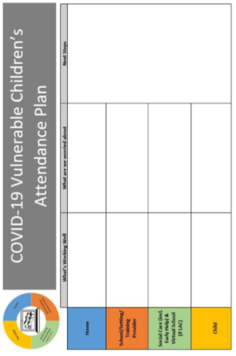
Vulnerable Pupils including our pupils with EHCPs
What are the outcomes so far of our discussions with vulnerable families and Children’s Social Care in relation to a phased return?
What is your current situation with agreed Attendance Plans for vulnerable pupils who are not already in your school?
  From: NYCC Guide to vulnerable children and young people Covid-19 attendance plan
  https://cyps.northyorks.gov.uk/covid-19

Slide 20
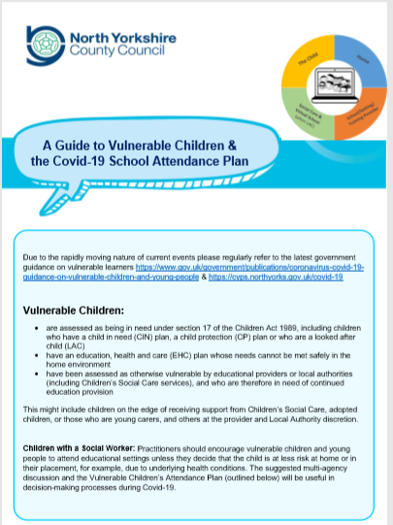
Guidance to support the return of vulnerable pupils not in school
NYCC Guide to vulnerable children and young people Covid-19 attendance plan
NYCC Safeguarding Guidance, North Yorkshire Safeguarding Guidance FAQs and for Vulnerable Learners not attending school
  https://cyps.northyorks.gov.uk/covid-19

Slide 21
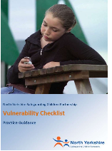
Levels of Vulnerability
All children who were vulnerable before the current situation remain vulnerable and for some that level of vulnerability will have increased
Are there opportunities for pupils to talk with staff about worries and concerns?
Has the DSL obtained an up to date position for all children open to services, in particular where their situation has changed and / or they have become open to services since the school closed?
How are you using the most up to date version of the NYSCP Vulnerability Checklist to inform your review of vulnerability and any referrals?
How is the vulnerability checklist being used more widely with staff making welfare calls and having return to school conversations ?

Slide 22
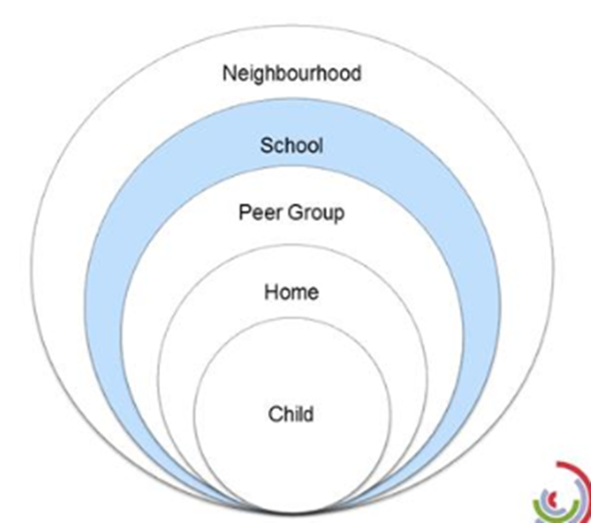
Emerging contextual issues during Covid-19
Child mental health including anxiety at returning to school
Experience of bereavement
Anxieties related to uncertainty re examination grades, next steps into training and employment, university
Challenging family relationships
Children having witnessed parental conflict
Children having witnessed domestic abuse (it is known that domestic abuse has increased under lockdown but referrals into Early Help have decreased)
Decrease in number of referrals for both children and adults
Likely increase in private fostering arrangements unreported during school closures/partial closures
Children and adults being isolated from their support structures and critical services which identify safeguarding issues
Parental mental health issues, substance misuse
Children struggling to readjust to the routine of school life
Students getting jobs before the official leaving dates for Year 11 - 26th June 2020
Increased numbers of families in challenging financial circumstances

Slide 23
Emerging contextual issues during Covid-19
Issues arising from on-line activity e.g. children viewing pornography, sharing images, child sexual and criminal exploitation
Peer on Peer abuse, especially online
Risky behaviour / Anti-social behaviour involving young people not required to return to school
Some young people are reporting that they are still accessing drugs although may have had to change the type of drugs they are purchasing due to problems with supply and demand
Some young people who had bought in bulk before lockdown to see them through the period. This relates largely to young people who take cannabis as appose to other drugs
Some of the national findings have identified increased use of taxis transporting children to move drugs (not really seen in North Yorkshire)

Slide 24
Emerging contextual issues during Covid-19
UK Youth | The impact of COVID-19 on young people & the youth sector https://www.ukyouth.org/wp-content/uploads/2020/04/UK-Youth-Covid-19-Impact-Report-External-Final-08.04.20.pdf
  Increased mental health or wellbeing concerns
  Increased loneliness and isolation
  Lack of safe space – including not being able to access their youth club/ service and lack of safe spaces at home
  Challenging family relationships
  Lack of trusted relationships or someone to turn to
  Increased social media or online pressure
  Higher risk for engaging in gangs, substance misuse, carrying weapons or other harmful practices
  Higher risk for sexual exploitation or grooming

Slide 25

Emerging contextual issues during Covid-19 – Domestic abuse
Domestic abuse crimes and reported incidents are currently slightly down/ in line with data pre lockdown
Reduction in Operation Encompass notifications
Concern that there are unreported cases
Domestic abuse arrangements/ services are still in place with support services being delivered differently
https://www.idas.org.uk/
IDAS have increased their web chats facilities
Staff training on domestic abuse
  Domestic Abuse Awareness Online Training
  Access online at: https://www.idas.org.uk/training
Govt guidance Coronavirus (Covid-19): support for victims of domestic abuse
https://www.idas.org.uk/resources/handbooks-leaflets-posters/

Slide 26
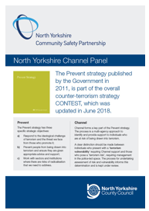
Prevent: National and Local Update
National
  Referrals 50:50 Far Right /Isis Daesh
  Terrorists/extremist exploiting Covid-19 to ‘hook’ into online chat forums and then into ‘closed more dangerous online spaces’
  Conspiracy theories inc 5g masts, fake news about other groups e.g. Muslim, Jewish community ‘spreading’ the problem
  Vulnerable are less able to access their ‘safe spaces’/protective factors e.g. schools
Local
See next 2 slides - most referrals are from schools with the average of person referred aged 15
New Channel Leaflet for North Yorkshire Professionals
https://www.safeguardingchildren.co.uk/professionals/practice-guidance/

Slide 27
North Yorkshire Police – Prevent Briefing
January – March 2020
National News
10/03/2020 The Prison Officers' Association (POA) has called for “fundamental review” of the UK prison de-radicalisation programmes. The convicted terrorist Usman KHAN had taken part in two programmes, and Sudesh AMMAN who injured the public in the Streatham knife attack had reportedly refused to engage with de-radicalisation. The POA National chair suggested that prisoners who did engage may be going ”through the motions”. BBC News
Local News and Issues
04/03/2020 Stickers, which appear to promote white supremacist views have been posted outside a primary school near York, police are actively seeking those involved. BBC News
05/03/2020 A Planned CTP operation evacuated an area of York utilising a bomb disposal unit in the arrest of a 21-year old man on suspicion of possession of documents likely to be of use to a terrorist. BBC News
26/03/2020 A man has pleaded guilty to possessing explosive substances, downloading terror manuals and discussing plans to launch an attack. Anwar Said DRIOUICH, 22, from Middlesbrough, is part of a misogynistic movement named ‘Incel’ which has been associated with at least six mass-shootings in the US.
Resources
Link to a Hate Symbols Database -> Hate Symbols
Counter Terrorism Local Profile (CTLP)
The 2019 CTLP for North Yorkshire has been sent to all Prevent leads. A not protectively marked version is available from your Prevent Lead or Prevent Police.
The key points to come out of this are:
The main threat to the UK remains International Terrorism, such as that posed by Daesh and Al-Qaida.
Within North Yorkshire the main threat is from the Right Wing
The primary method used in recent attacks is low-technology Lone Actor offences, where knives and vehicles are used.
Training, Events and Communications
In January 2020 Prevent Police presented at the Head teachers/ designated safeguarding leads network days with a whistle stop tour of Prevent and Channel.
Due to COVID-19 the police Prevent Champions training for May, and the multi-agency training planned for June has been cancelled with no new date planned as yet. We may look to host something virtual later in the year.
From April to September North Yorkshire Police will be promoting Prevent and Lets Talk about It messaging on Social Media, support this by sharing our messages and following us @NypPrevent
Prevent Military Meetings
These are currently suspended and will recommence asap

Slide 28

Referrals By Gender
0% Female
100% Male
Average age 15

Slide 29
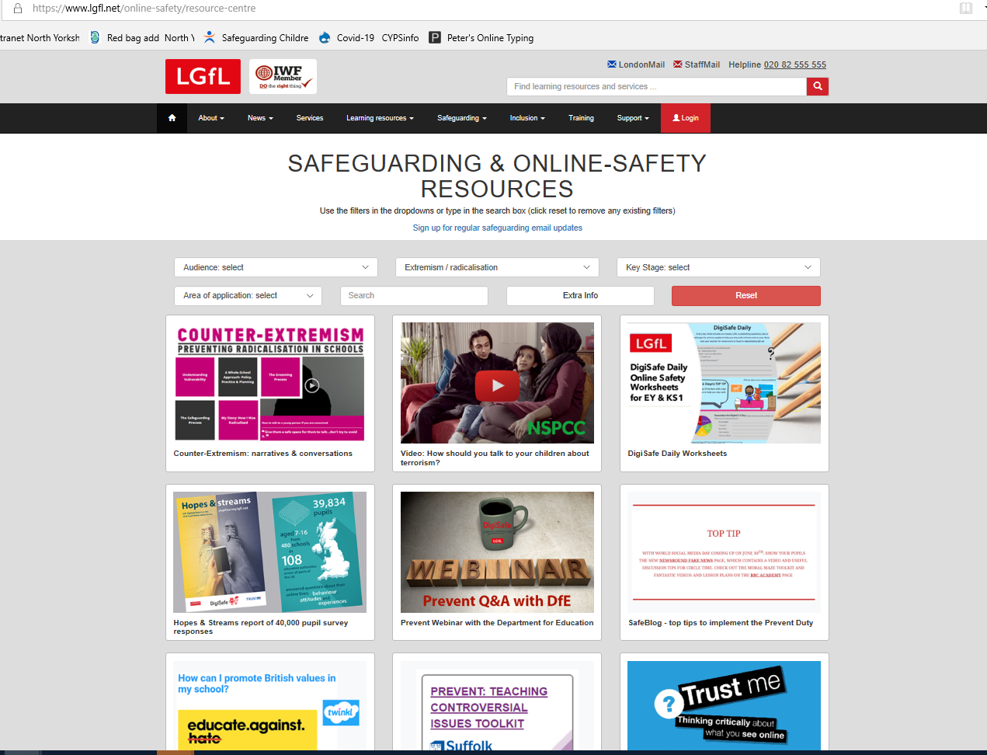

Prevent: actions
Encourage staff to share concerns with DSLs and follow usual safeguarding procedures – provide evidence even if more limited than typical e.g. concerns from staff/parent phone calls
Seek advice from North Yorkshire local Prevent officers
Use of supporting resources for pupils and parent/carers
https://www.lgfl.net/online-safety/resource-centre
https://www.ltai.info/

Slide 30
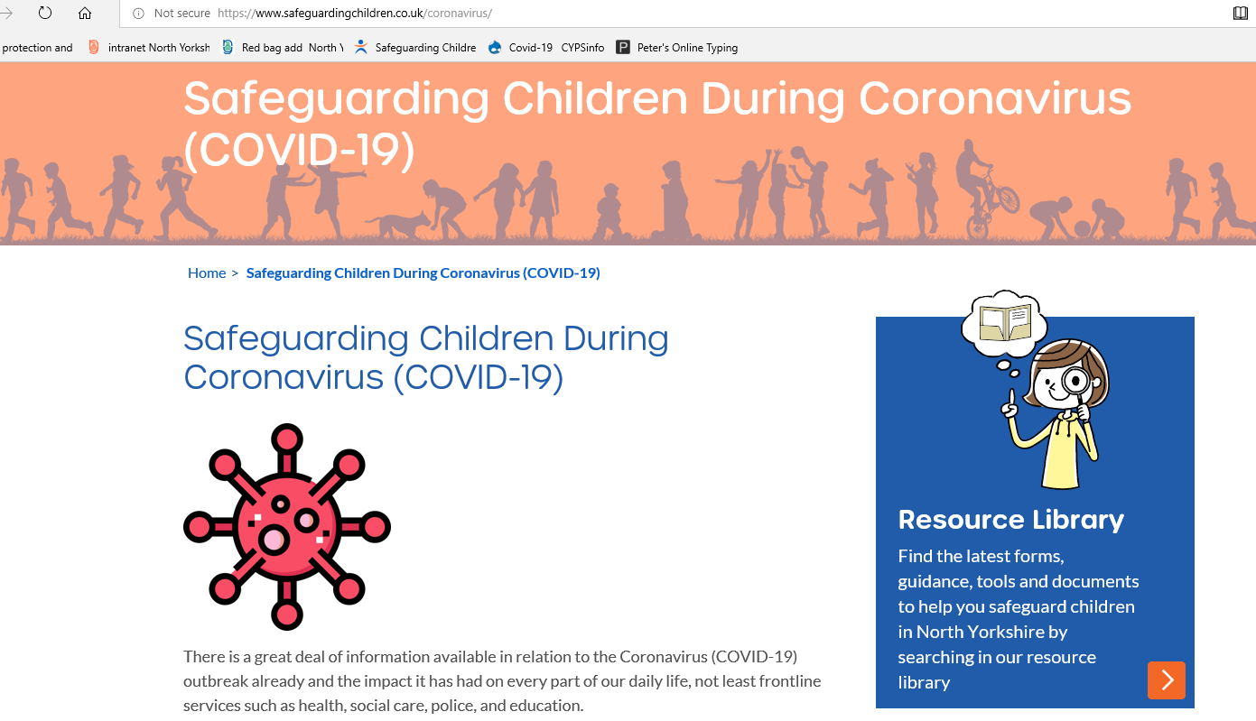
NYSCP Temporary Changes
Face-to-face meetings cannot be held until further notice. These include Child Protection Conferences, and Looked After Reviews.
These meetings are still taking place through different means (school initiated meetings in line with school’s acceptable use policies- to zoom or not to zoom..)
See Participation in Child Protection Conferences: Families and Professionals arrangements - guidance for schools
https://www.safeguardingchildren.co.uk/coronavirus/

Slide 31

NYSCP partner organisation support during Covid-19
It is business as usual for many safeguarding partner organisations during COVID-19
However there are different engagement opportunities taking place from face to face to virtual engagement
Some feedback from young people and professionals is that children and young people like the virtual contact with professionals
A number of workers have been creative about how they have engaged with young people….e.g. taken them out for a walk/met in an area where they can keep social distancing.

Slide 32
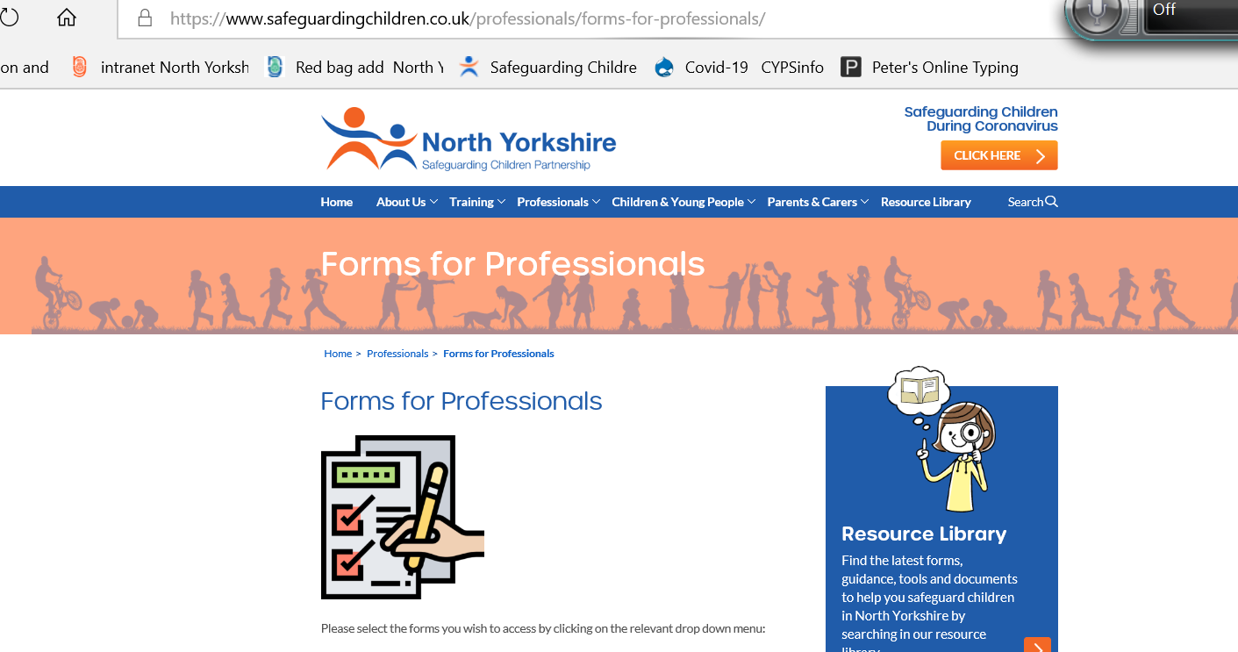
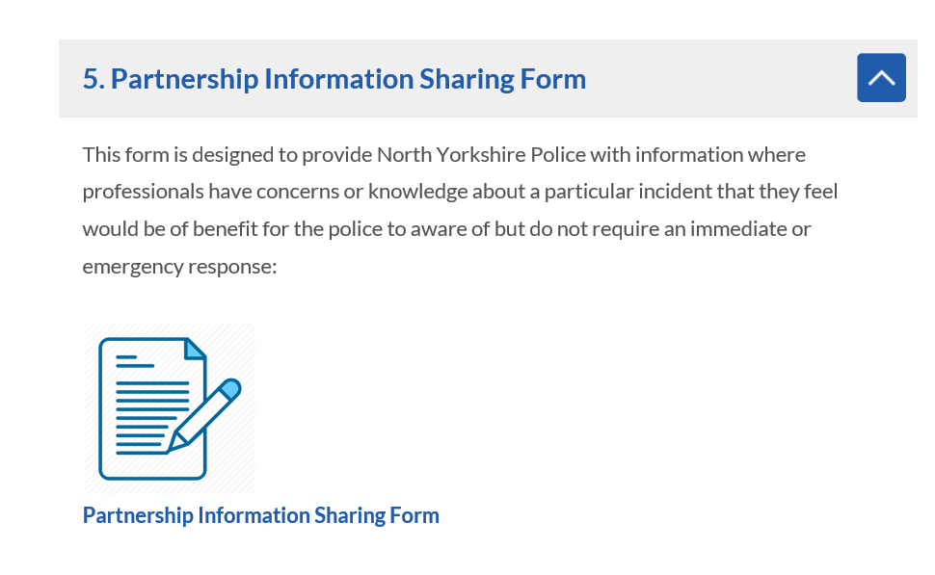
NYSCP: Children currently identified as at risk of exploitation
Whilst a number of children have not been able to attend school during lockdown, the vast majority of children currently identified as at risk of exploitation are entitled to be in school. There has been some really creative and persistent work by schools, specifically PRS in trying to access those hard to reach children.
Continue to submit intelligence via the partnership information sharing form - designed to provide North Yorkshire Police with information where professionals have concerns or knowledge about a particular incident that they feel would be of benefit for the police to aware of but do not require an immediate or emergency response: https://www.safeguardingchildren.co.uk/wp-content/uploads/2019/09/V3-Partnership-Information-Form-Feb.docx

Slide 33
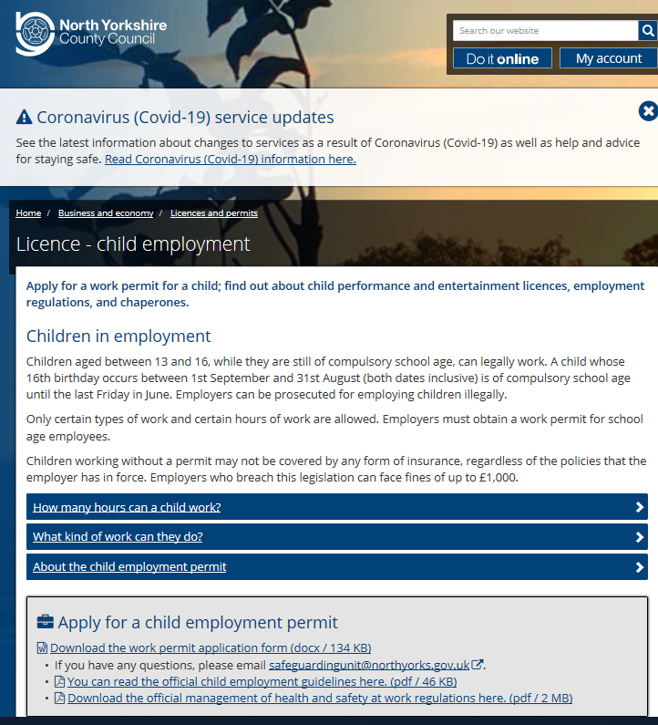
Emerging contextual issues during Covid-19 LA Guidance on Year 11 taking jobs before 26th June 2020
Y11’s still require a child work permit up until the 26th June 2020
The employer/employee is not insured without one
Live permits have not been revoked and employers are required to keep within child employment legislation as well as Covid-19 secure guidelines
If children of compulsory school age are working, schools need to forward the information to Ursula.Hugill@northyorks.gov.uk who will take appropriate action from within the child employment pathway.

Slide 34

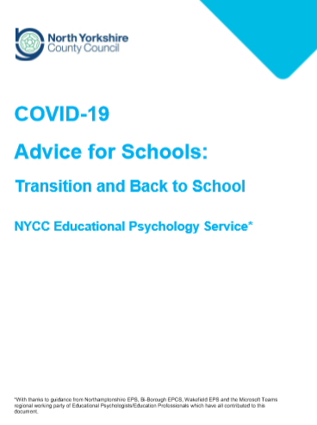
LA Wellbeing Guidance
Transition Document –Guidance to support the wider opening of schools
  Appendix 6 Wellbeing guidance – detailed support for schools with links
Transition and Back to School guidance from NYCC Educational Psychology Service
https://cyps.northyorks.gov.uk/covid-19-working-towards-wider-re-opening-schools

Slide 35
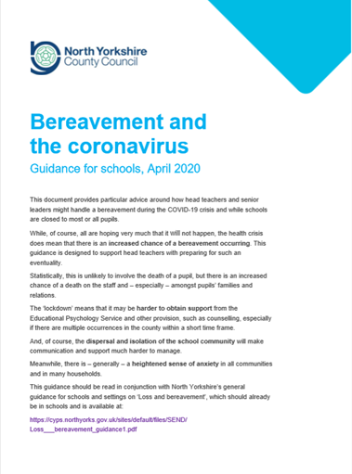
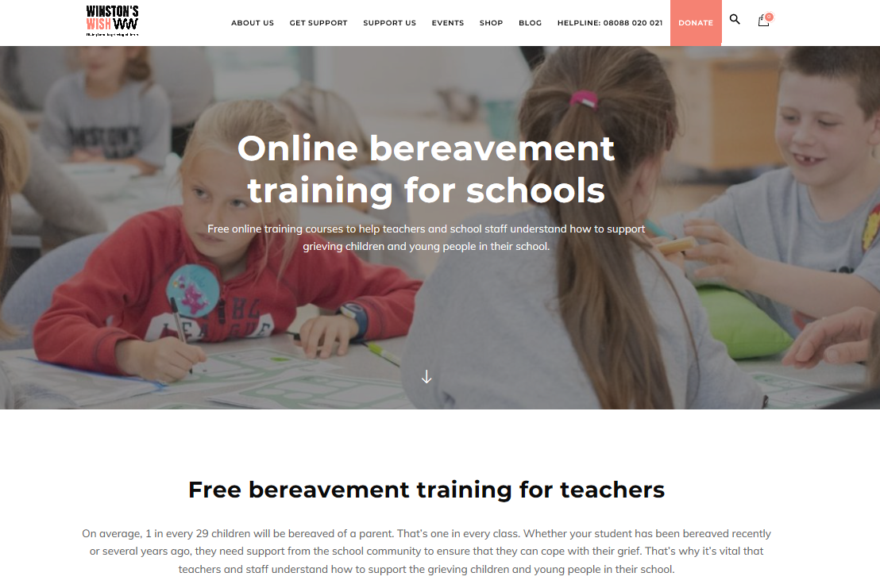
Bereavement Guidance during Covid-19
Childhood bereavement: online training
  An introductory course on childhood bereavement and what you can do to help those going through it, aimed at both primary and secondary schools
https://www.winstonswish.org/bereavement-training-courses-schools/

Slide 36
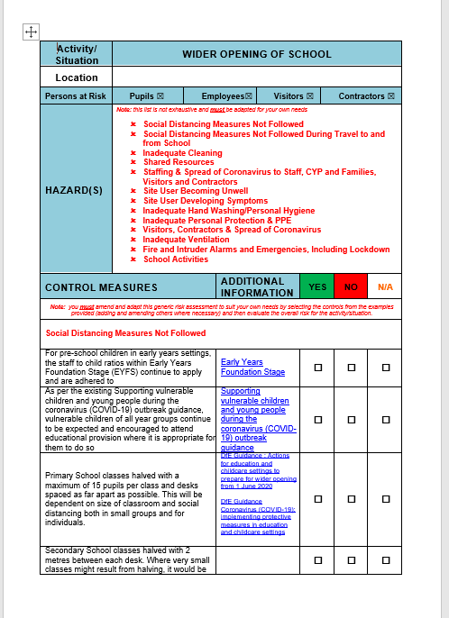
Healthy and Safety Risk Assessment
Have you carried out a risk assessment before opening, directly addressing risks associated with coronavirus (COVID-19), and considered control measures?
Are staff aware of their roles and responsibilities in implementing the control measures in the risk assessment?
Notes:
The slides on Health and Safety Risk Assessments may be covered in other Health and Safety staff training session

Slide 37

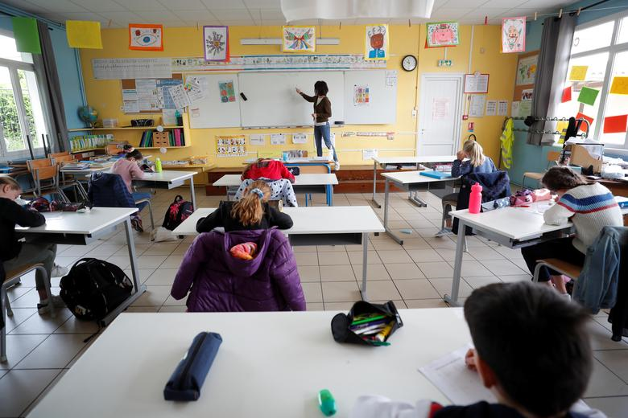

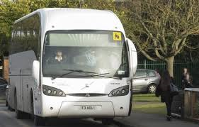
Healthy and Safety Risk Assessment
Managing social distancing
  On the way to school
  Parent/Carer handovers
  At school
Classroom activities
Managing the sharing of resources
What to do if someone is unwell
Hand washing/Personal hygiene
Ventilation
Visitors/contractors
Personal protective equipment
Fire/lockdown procedures
DfE Safe working in education, childcare and children's social care, including use of PPE
Notes:
The slides on Health and Safety Risk Assessments may be covered in other Health and Safety staff training session

Slide 38
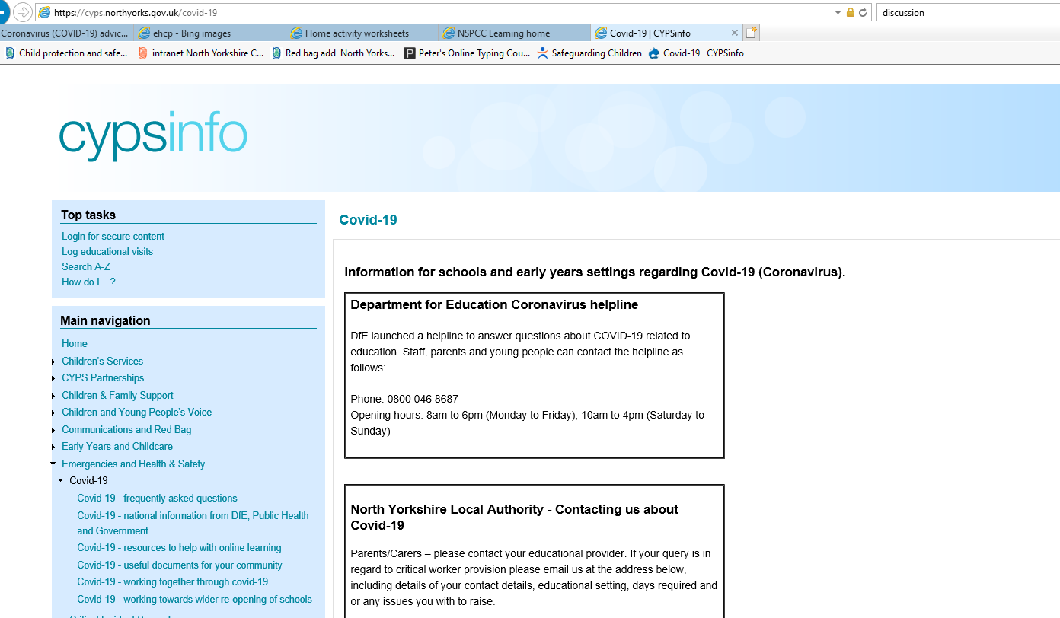
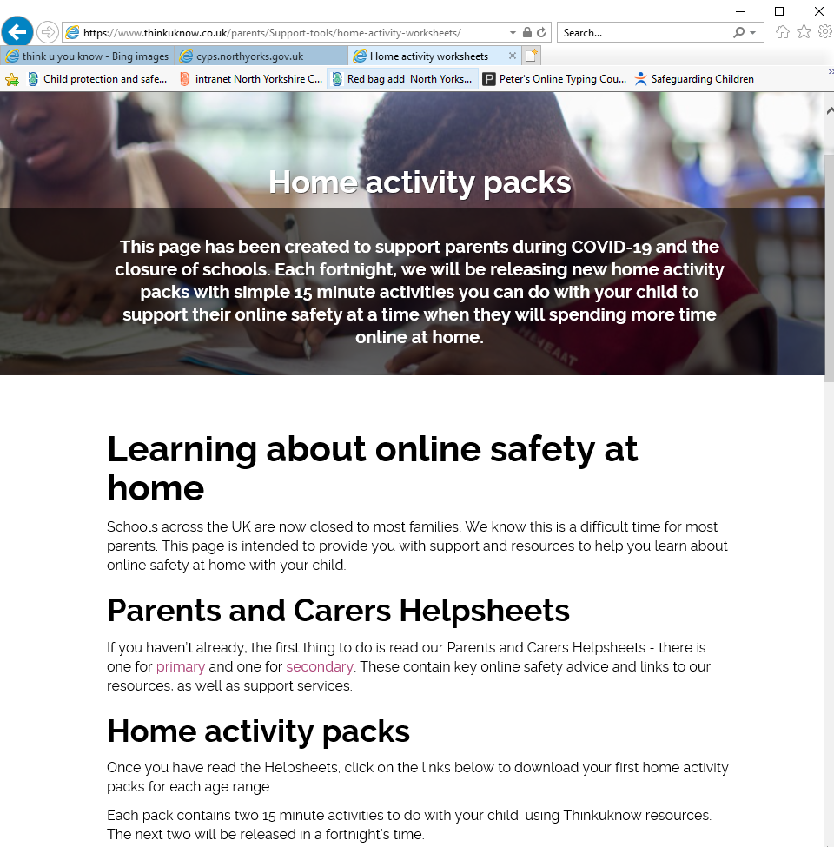
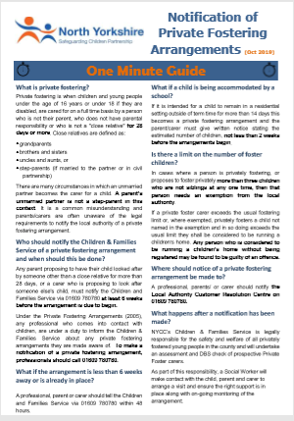
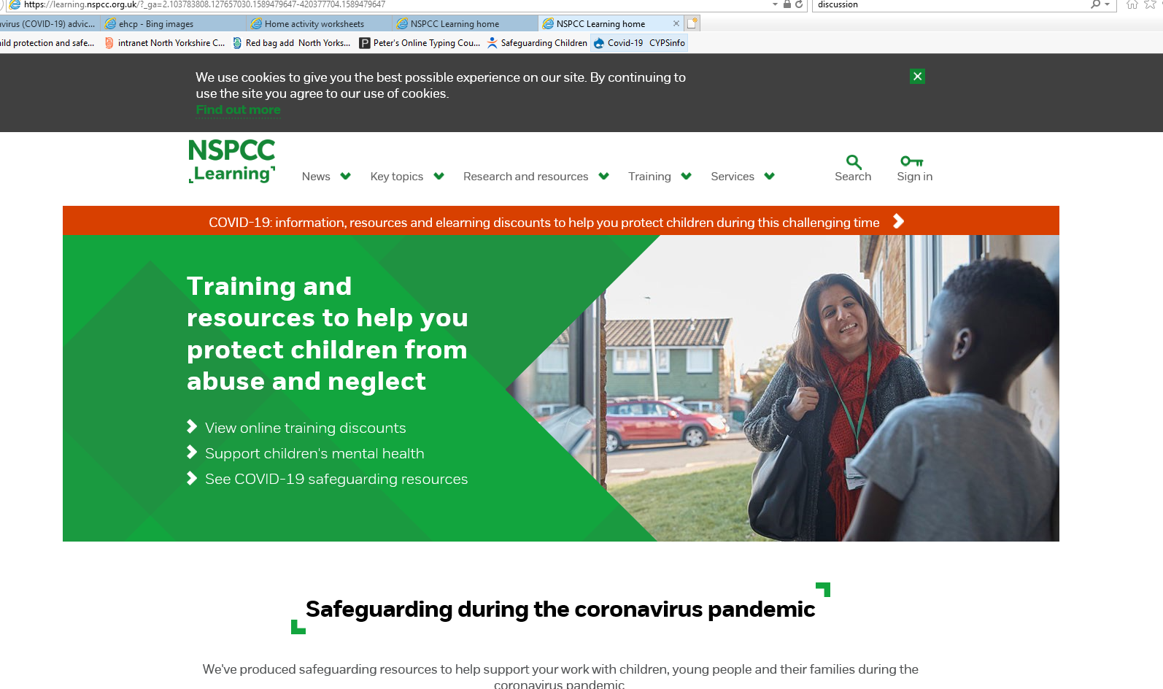
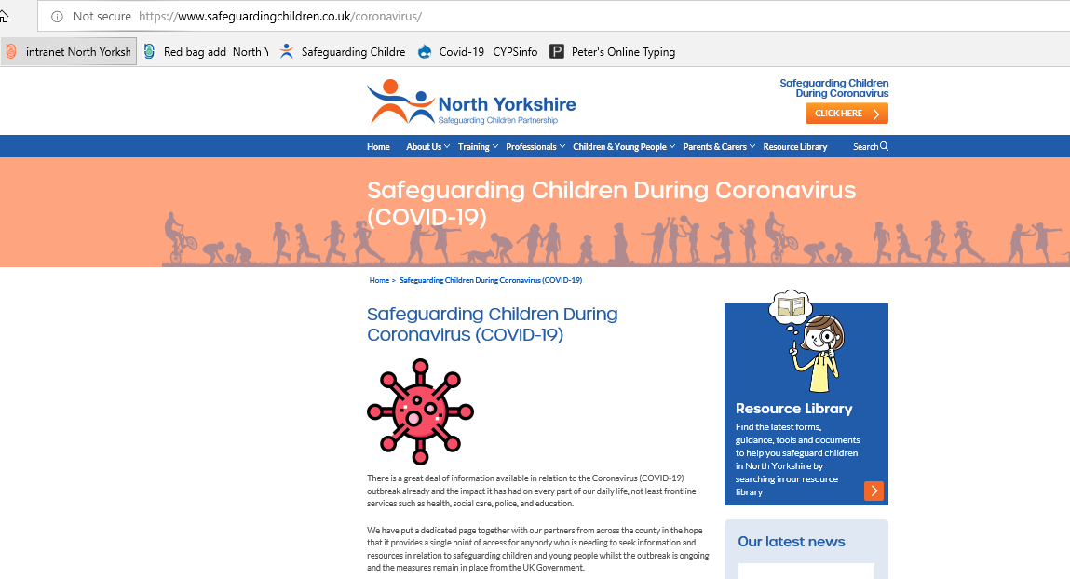
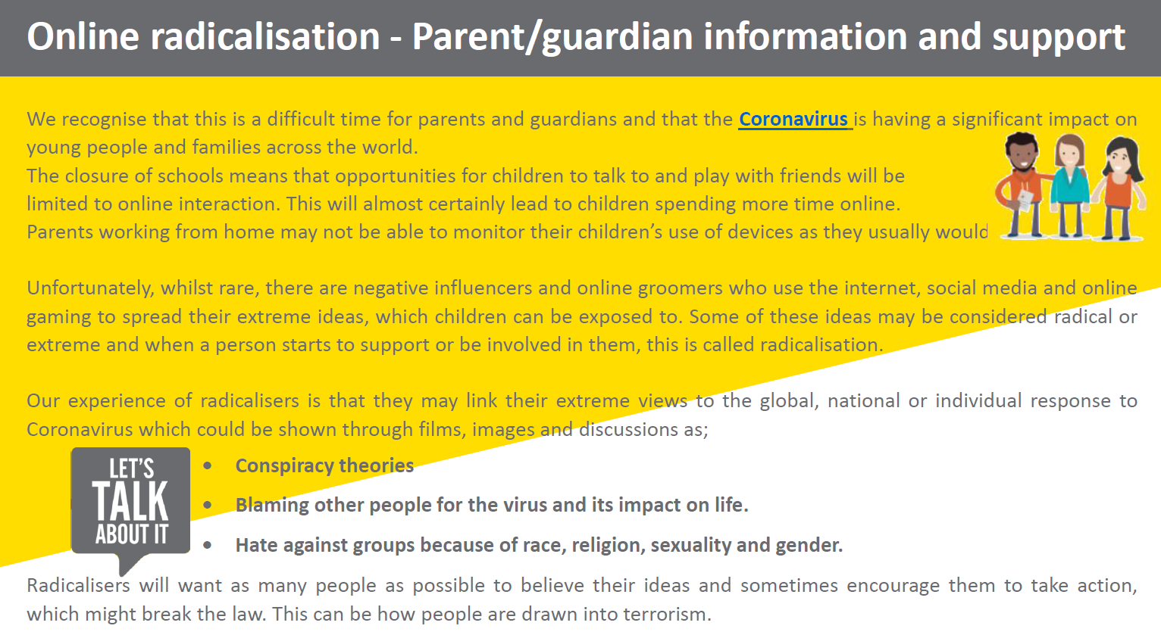
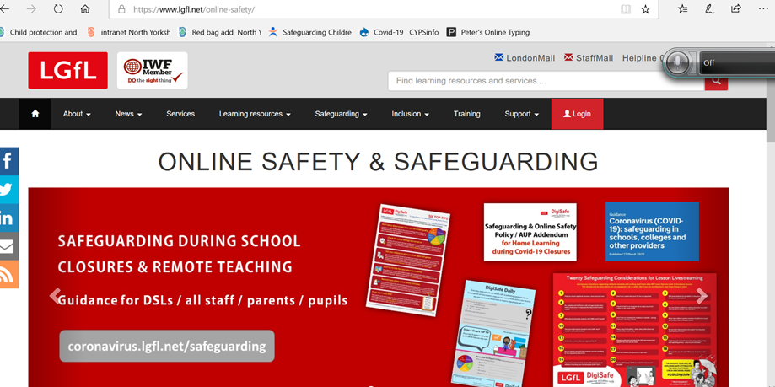
Guidance and support available

Slide 39

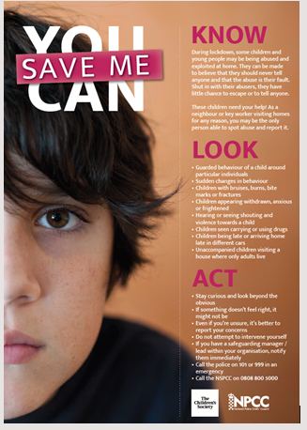
NYSCP May 2020 edition of the NYSCP e-Bulletin
Sign up to NYSCP e-Bulletin
Updated Early Help Assessment Form
Child Sexual Abuse and Exploitation during Covid-19
Safeguarding Awareness for Volunteers
North Yorkshire Social Worker receives award for contributions to tackle exploitation
Stop the Traffik Briefing: Exploiters targeting homeless hostels
Child Safety Week 1st-7th June ''Safety Makes Sense''
CEOP #OnlineSafetyAtHome: New packs available to download and New Video for Parents & Carers
Sexual Assault Referral Centre (SARC) Services across Yorkshire & the Humber
Learn Online with PACE
Relationship Matters
Policing the Pandemic Survey for Young People Launched
Useful Links

Slide 40
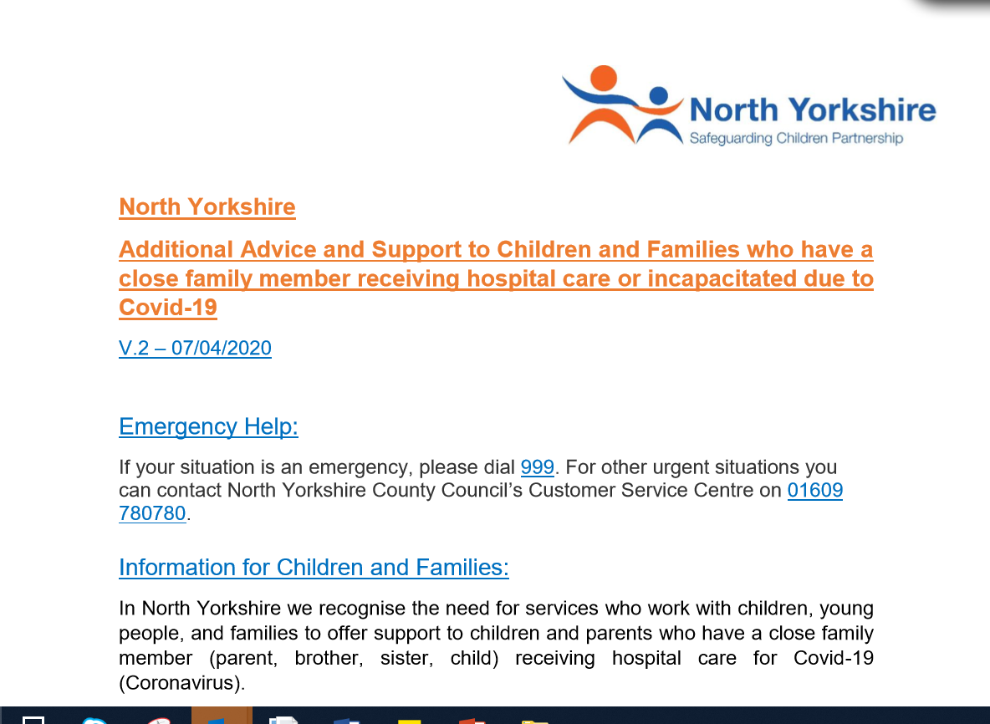
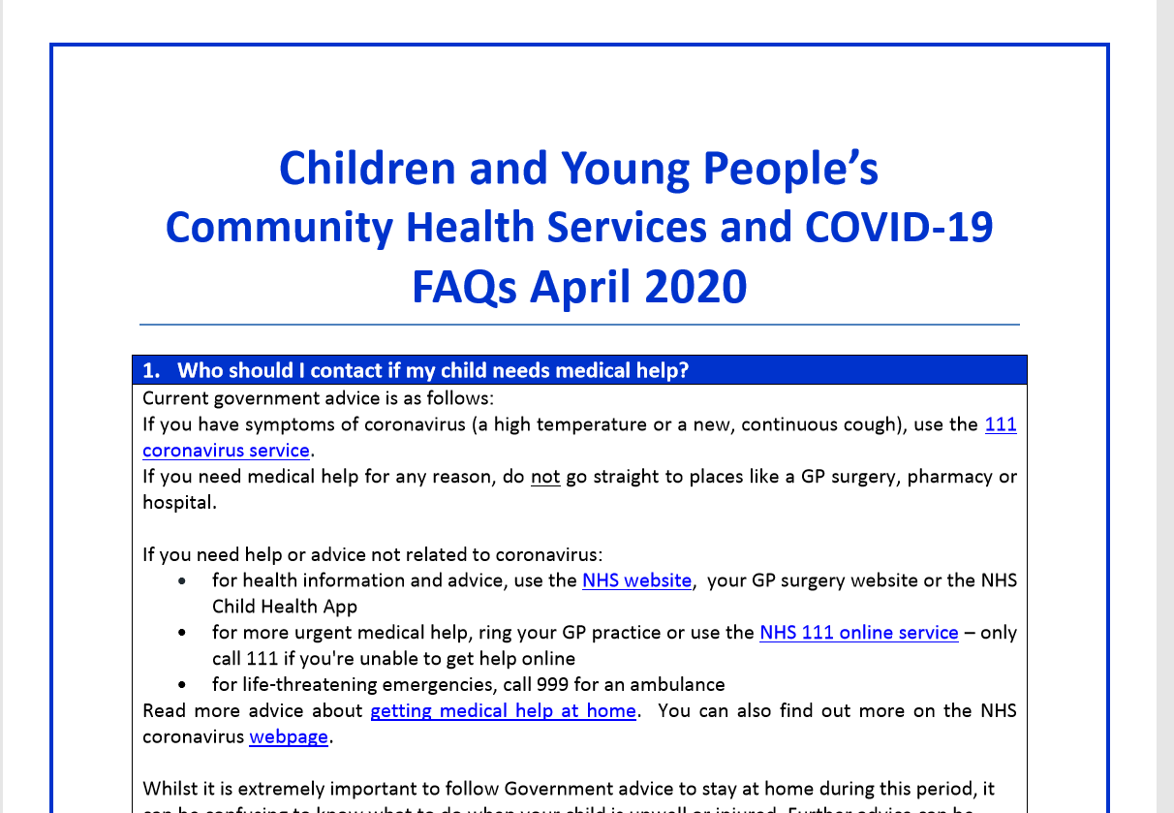
Additional Covid-19 Local Advice and Support for Children and Families
https://cyps.northyorks.gov.uk/covid-19-useful-documents-your-community
https://www.safeguardingchildren.co.uk/coronavirus/

Slide 41

NYES Designated Safeguarding Lead Training
NYCC Comprehensive Child Protection Pathway (CCPP) training and the CCPP refresher training will both be temporarily available as webinars
More details from
www.nyeducationservices.co.uk

Slide 42



Other sources of safeguarding resources that have been flagged up by schools to support DSLs
https://www.safeguardinginschools.co.uk/
https://safeguarding.network/
http://aacoss.org/professionals/

Slide 43
Key Guidance
National GOV.UK Coronavirus Covid-19 Education and Childcare Portal to all DfE Coronavirus (Covid-19) guidance DFE Guidance Coronavirus (Covid-19): safeguarding in schools, colleges and other providers Local North Yorkshire Children and Young People’s Service https://cyps.northyorks.gov.uk/covid-19 North Yorkshire Safeguarding Children Partnership https://www.safeguardingchildren.co.uk/coronavirus/
Are all your staff and governors up to date with government and local Covid-19 guidance on safeguarding?

