Slide 1

Safeguarding
Hidden Harm
COVID -19
June 2020

Slide 2


Purpose
This presentation is to support school Designated Safeguarding Leads (DSLs)
It includes
  What is Hidden Harm?
  Update on the NYSCP Hidden Harm campaign #TellUsYourConcerns (June 2020)
  Strategies used by schools making a strong contribution to the concerns about Hidden Harm during Covid-19
  Support and guidance for schools
  Role of Children and Families Service

Slide 3

What is Hidden Harm?
“Even though people are in their homes more than ever before, it doesn’t mean they are out of harm’s way
Children and young people across North Yorkshire could find themselves in harmful situations compounded by the lockdown
And because they aren’t going to school, seeing friends or interacting with professionals it may be harder to pick up on’’
Stuart Carlton - Corporate Director of Children and Young People’s Service June 2020

Slide 4

Hidden Harm - what are the issues affecting children and families?
Pressures of social isolation and lock down have increased the potential of harm to children and young people, including
  mental health
  exploitation, which includes online activity and other forms of abuse and harm which can include from peers
  domestic abuse
  substance misuse

Slide 5

Hidden Harm - what are the issues affecting children and families?
Social isolation and the risk of child abuse during and after the coronavirus pandemic
NSPCC – June 2020
https://learning.nspcc.org.uk/research-resources/2020/social-isolation-risk-child-abuse-during-and-after-coronavirus-pandemic

Slide 6
NSPCC Social isolation and the risk of child abuse during and after the coronavirus pandemic – June 2020: Key Findings
  Increase in stressors to parents and caregivers
  Increase in children and young people's vulnerability
  Reduction in normal protective services
‘For most children and young people, this has been the longest stretch of time in their lives spent away from friends and trusted adults outside the home.
The impact of lockdown on children’s emotional and mental health, combined with almost full-time confinement in their homes and changes to their routines, has created new vulnerabilities and exacerbated existing ones’
https://learning.nspcc.org.uk/research-resources/2020/social-isolation-risk-child-abuse-during-and-after-coronavirus-pandemic

Slide 7
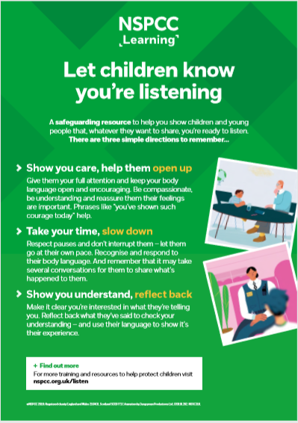
NSPCC Social isolation and the risk of child abuse during and after the coronavirus pandemic – June 2020:
Recommendations for schools
Schools should have comprehensive support plans in place including:
  Reviewing support for all children currently known to the designated, named or lead safeguarding or child protection officer
  Ensuring they identify any children who are missing from education and sharing timely information with their local authority;
  Putting comprehensive support in place for staff to enable them to support children confidently, including training on child development science and how trauma can manifest in behavioural problems or poor emotional regulation.
  The NSPCC resource on disclosure (Let Children Know You Are Listening) should be shared.
NSPCC Social isolation and the risk of child abuse during and after the coronavirus pandemic – June 2020

Slide 8
Wider opening: mental health and wellbeing priority
Mental health difficulties are presenting as the main issue in both adults and children and in parents, I have heard reports of suicidal ideation …. This relates to the lack of routines, non-school attendance, too much technology as parents … use technology to give them peace, … sleep patterns are disrupted and many families are reporting they are sleeping later and going to bed later … There also appears to be an increase in substance misuse, both with families engaged with addiction services and families imbibing in alcohol to help them ‘cope’. Lack of stimulation for children and adults, boredom and parents feeling at a loss as to how to keep their children entertained. Together for Childhood Diaries Project
Enhanced support for all children should include:
comprehensive identification of the range of issues that might adversely affect children’s wellbeing and mental health;
a bespoke plan for the first few weeks back in these settings (including an inclusive approach to behaviour management);
good joint working with partners to ensure children with identified needs receive early help and support.
NSPCC Social isolation and the risk of child abuse during and after the coronavirus pandemic – June 2020

Slide 9
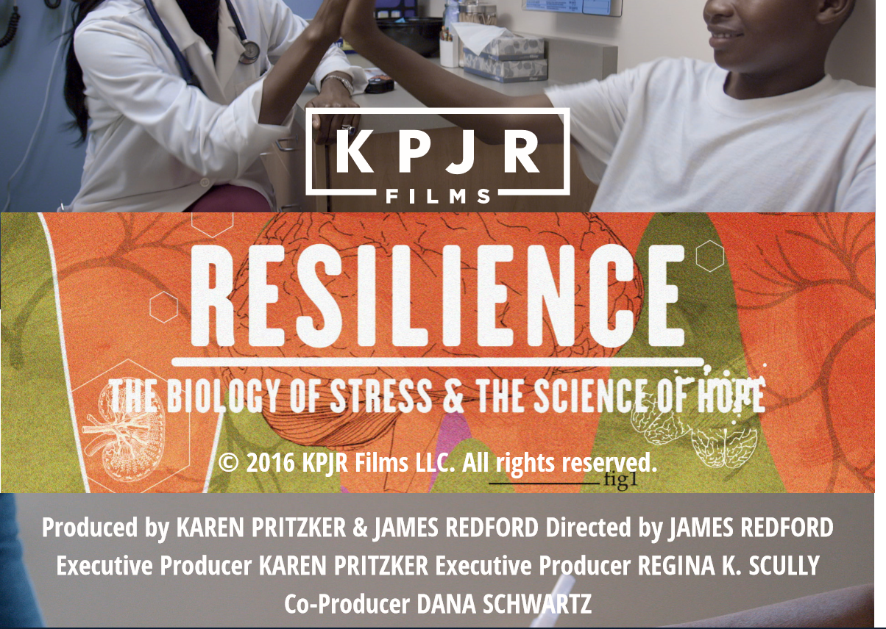
Hidden Harm and Adverse Childhood Experience
Adverse Childhood Experiences
  These are stressful or traumatic events including abuse and neglect
  They may also involve household dysfunction such as domestic violence or growing up with family members who have substance misuse disorders
Please contact the NYCC Virtual School for more information and how to access
  https://vimeo.com/434377424
  Password: NYCC2020
  Monday 6 July 1-6pm
  Monday 13 July 1-6pm
  Further screenings will be available from September.
Notes:
Haydn

Slide 10



Domestic Abuse
NSPCC (2020) The impact of the coronavirus pandemic on child welfare: domestic abuse. Insight briefing. London: NSPCC.
I really need your help; my dad has been physical abusing my mum. He has an anger problem and it's getting out of hand. The smallest things make him angry and he starts shouting. I'm terrified of him and I've had enough, I can't take it any more - please help me!
Boy, aged 14, Childline
Staff training on domestic abuse
Domestic Abuse Awareness Online Training
Access online at: https://www.idas.org.uk/training

Slide 11
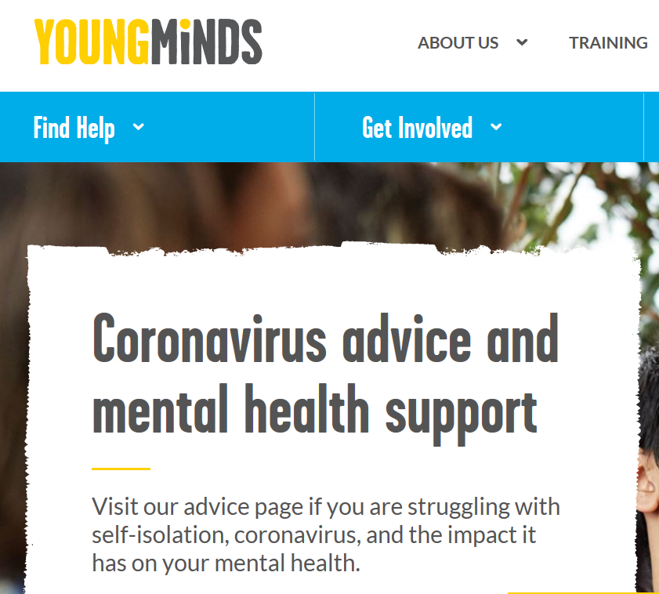
Mental Health
83% of young people with mental health needs have said the coronavirus pandemic has made their mental health worse
Source: Survey YoungMinds report 30th March 2020

Slide 12
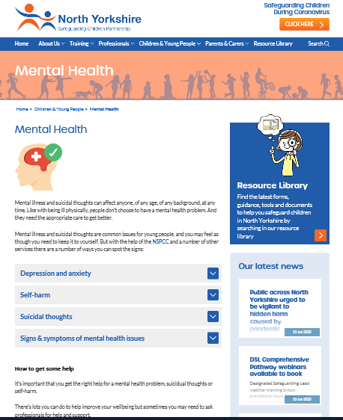
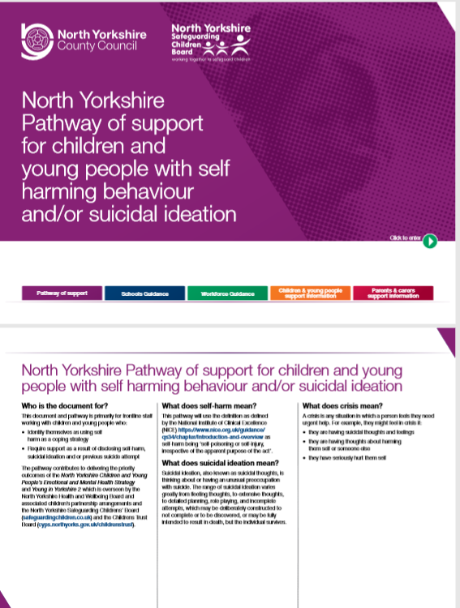
Mental Health
NYSCP Mental Health Guidance materials
https://www.safeguardingchildren.co.uk/children-young-people/mental-health-2/

Slide 13
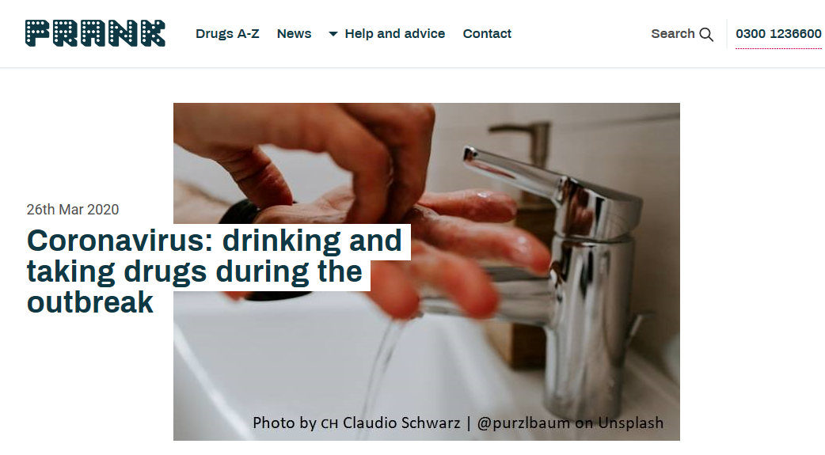
Substance Misuse
Children living with parental problem alcohol or other drug use need access to support and advice.
The impact can have a devastating effect on children and can affect them for the rest of their lives.
At the most conservative estimate 1 in 11 children are living in a situation where alcohol or other drug use is an issue.
These children can have difficulty in developing trusting relationships. Their experience is that adults let them down and they have to do everything, even provide for themselves.
Adults working with these children can make a significant difference if they know how.
https://www.talktofrank.com/news/coronavirus

Slide 14


Online Child Sexual Exploitation
It is highly probable that numbers of online child sexual exploitation (OCSE)cases will increase during the period of COVID-19 restrictions
Greater unsupervised internet use means children are likely to be exposed to greater risk of sexual exploitation online, including sexual coercion, extortion and manipulation
Exchange of self-generated material is also likely to increase, as children are now experiencing most of their social lives only online
The increase in the numbers of emotionally vulnerable children poses greater risk for increased grooming by offenders
COVID-19 restrictions are disrupting reporting services, with current systems still reliant on human moderation
(WePROTECT Global Alliance Intelligence Brief IMPACT OF COVID-19 ON ONLINE CHILD SEXUAL EXPLOITATION https://www.weprotect.org/products)

Slide 15

Child Criminal Exploitation
‘While there are indications that county lines activity may have decreased during lockdown, there are also signs that this period has created new recruitment opportunities for gangs and the potential of a spike in renewed activity when lockdown eases’
NSPCC Social isolation and the risk of child abuse during and after the coronavirus pandemic – June 2020

Slide 16

North Yorkshire Hidden Harm Campaign
Campaign launch June 2020
Communities across the whole of North Yorkshire are being urged to be vigilant and #TellUsYourConcerns

Slide 17

Safeguarding Week took place w/b 22nd June
“Safeguarding is everybody’s business”
Safeguarding week promoted a theme each day from Monday to Friday
  Monday: Domestic Abuse
  Tuesday: Keeping Safe Online
  Wednesday: Radicalisation
  Thursday: County Lines and Cuckooing
  Friday: Mental Health and Wellbeing

Slide 18


Pause
Questions
School Practice

Slide 19


Recognising Hidden Harm
Possible indicators
  Poor school attendance or late arrival, unexplained absence
  Unkempt / dirty / inadequate clothing
  Homework/Home on line learning not done
  Hungry
  Overly tired or poor concentration
  Unexplainable failure / over achieving
  No money
  Having more money, clothes, jewellery or other items that they usually couldn’t afford, such as a new phone
  Appearing overly resilient/competent mature
  Self-harm
  Any warning signs of fabricated and induced illness, female genital mutilation
https://www.safeguardingchildren.co.uk/professionals/practice-guidance/
Including updated one-minute guides

Slide 20
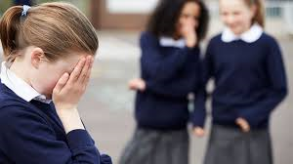

Recognising Hidden Harm
Behaviours you may observe
  Becoming unusually withdrawn
  Aggression and increasingly argumentative
  Sudden disrespectful attitude to others
  Become overly demanding to gain attention
  Overly compliant
  Excessively vigilant
  Seeking approval or affirmation constantly
  Poor social relationships, difficulty mixing, compounded by isolation
  Taking unhealthy risks, including with drugs/alcohol/solvents
  Secretive
  Concerns about the individual’s social media and internet usage
  Associating with groups or people that cause concern
  Change in friendship groups and appearance due to new influences, gang-association
  Inappropriate sexualised behaviour

Slide 21
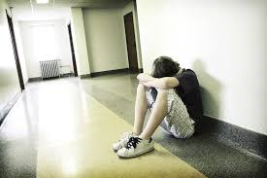
Recognising Hidden Harm
Emotions
  Anxious
  Sad
  Angry
  Fearful
  Embarrassed
  Ashamed
  Despairing
  Hurt
  Flat / Low Mood
  Numb
  Feelings of failure
Other possible indications
  Low self-esteem
  Avoidance
  Getting upset
  Expressing strong opinions or bravado
  Sympathetic and expressing views related to extremist ideologies and groups
  Expressing grievance/injustice triggered by racism or discrimination or aspects of Government policy
  Embracing conspiracy theories
  Concerns over use of symbolism, possession of extremist literature
  Failure to get excited about events
  Getting upset around holidays and birthdays
  Taking responsibility for siblings, parents or others
  Child’s illness or health needs which are not witnessed by the professionals

Slide 22

Hidden Harm - it is recognised schools are having to work in a very different way during Covid-19
Some children and young people are not seeing teachers and school staff every day and may not have the face-to-face interaction with healthcare professionals, social workers or support structures they may have normally

Slide 23

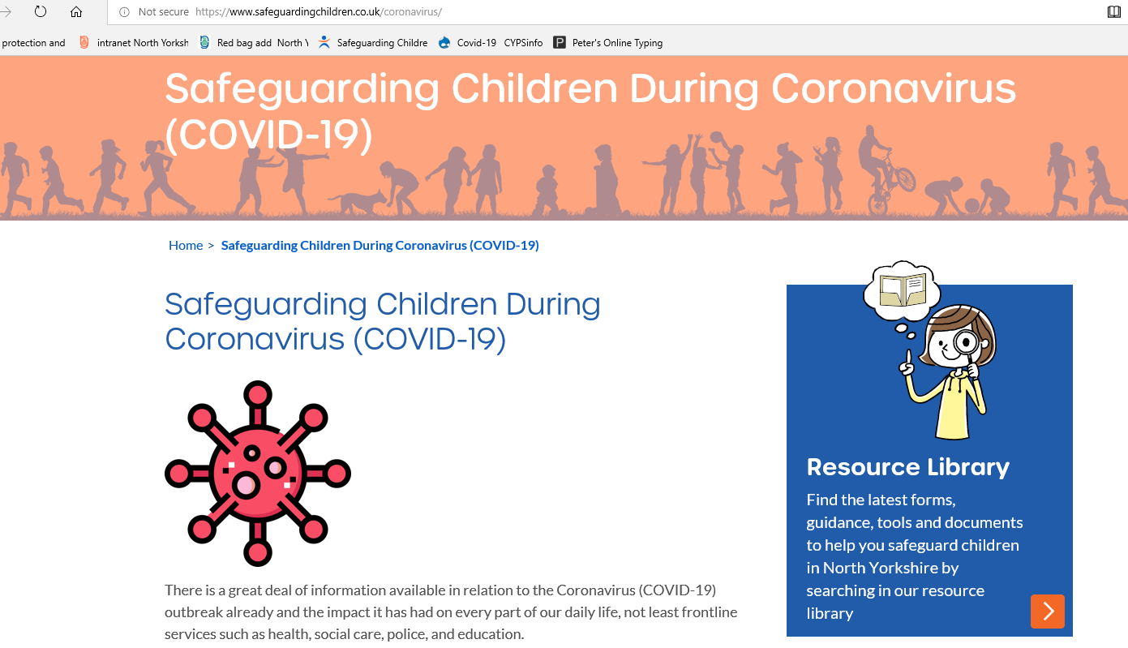
What is already happening in schools which is a strong contribution to the Hidden Harm partnership strategy
  Maintaining regular contact with children and young people not yet able to return to school
  Keeping channels of communication open with parents /carers and picking up welfare concerns
  High focus on wellbeing on return to school
  Staff safeguarding briefings – emerging contextual issues during Covid-19
  High vigilance and identification of concerns by staff
  Sharing of concerns through agreed local safeguarding procedures
  Participation in virtual safeguarding strategy meetings
  Attendance plans – review enables vulnerable children and young people to share worries/concerns

Slide 24
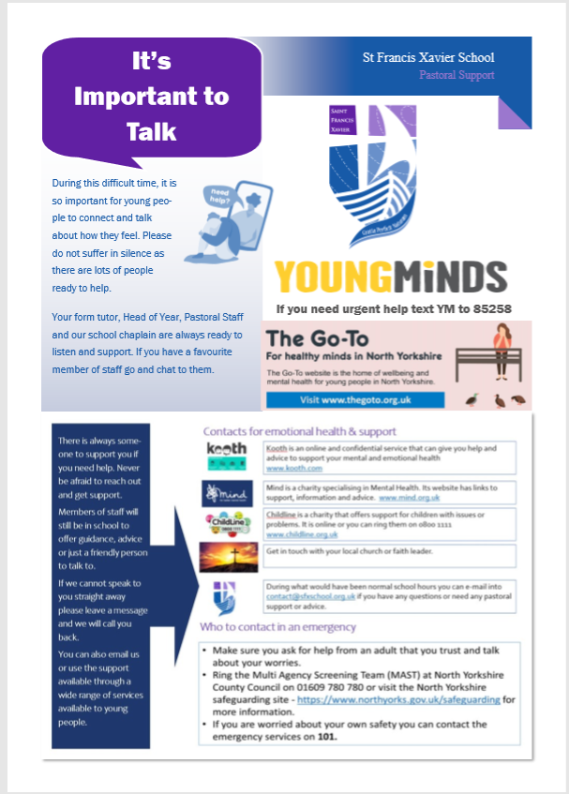
Opportunities for children and young people to talk
Many examples of North Yorkshire schools encouraging children and young people to share their worries and concerns and how to access support…

Slide 25
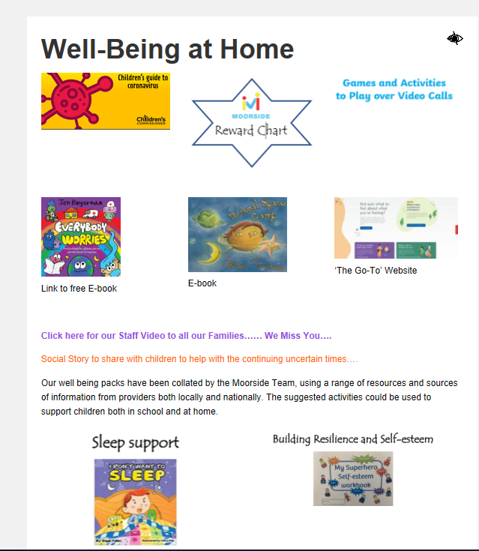
Supporting children at home
Many examples of North Yorkshire schools supporting the wellbeing of children who are not yet able to return to school…
https://www.moorsideschools.org.uk/

Slide 26

Curriculum teaching sessions
Many schools are planning wellbeing and safeguarding priorities within the curriculum – remote learning and for pupils in schools

Slide 27

Curriculum teaching sessions
Many schools are planning wellbeing and safeguarding priorities within the curriculum – remote learning and for pupils in schools
If delivering by remote learning the PSHE association have produce some guidance for schools to assess what would be appropriate for home learning https://www.pshe-association.org.uk/content/coronavirus-hub
A range of supporting resources are signposted in the NYCC
  PSHE and Citizenship guidance for schools KS 1-4 http://healthyschoolsnorthyorks.org/pshe-resources/
  Equalities and Diversity/Prevent https://cyps.northyorks.gov.uk/equalities-and-diversity
  https://cyps.northyorks.gov.uk/prevent
(and the return to school wellbeing document referenced on the next slide)

Slide 28


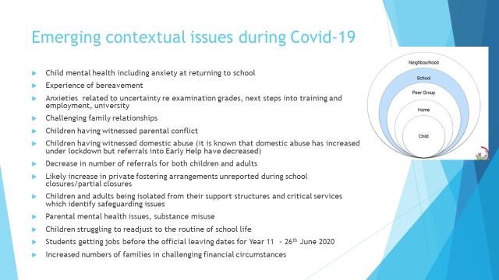
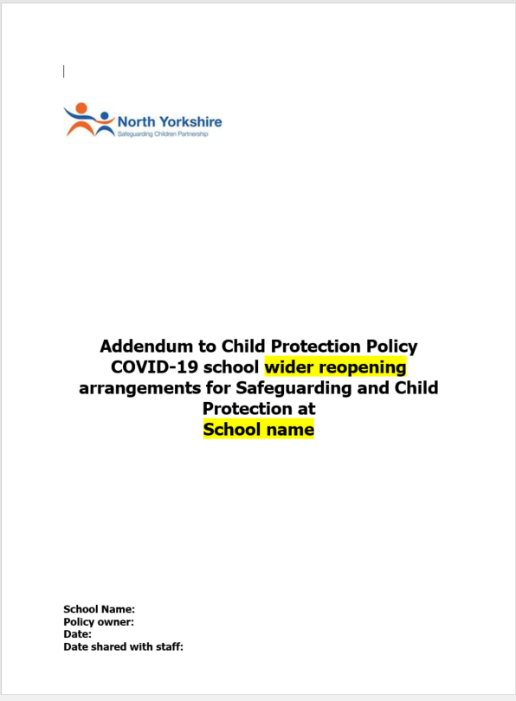
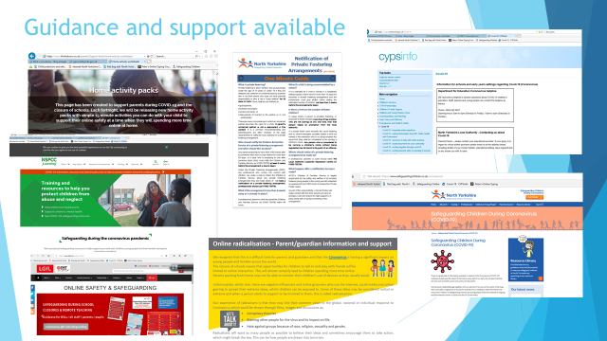
Guidance for schools to support the Hidden Harm Strategy
Transition Document –Guidance to support the wider opening of schools
  Appendix 6 Wellbeing guidance – detailed support for schools with links
Transition and Back to School guidance from NYCC Educational Psychology Service including Attachment and Trauma aware schools training/emotion coaching
Safeguarding Presentation for DSLs June 2020 inc emerging issues during Covid 19 related to hidden harm, national and local guidance
Child Protection Policy Addendum June 2020
https://cyps.northyorks.gov.uk/covid-19-working-towards-wider-re-opening-schools

Slide 29
Pause
Questions
School Practice

Slide 30
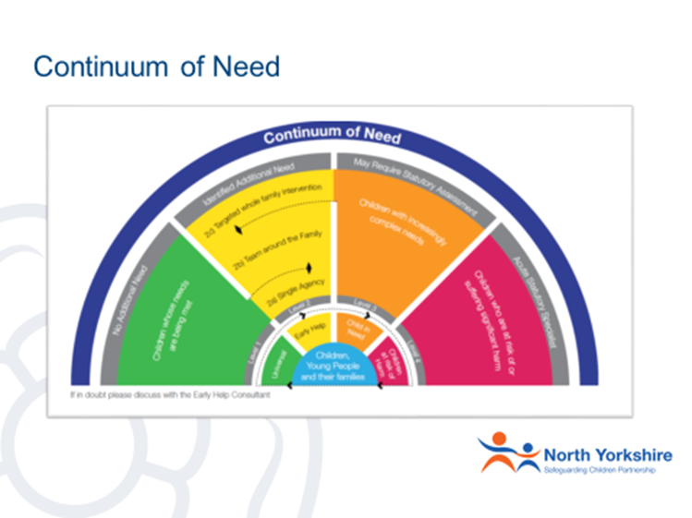
How is Early Help supporting schools to identify and respond to Hidden Harm concerns?
Providing additional support for children with emerging needs to stop escalation (Level 2)
2a Single Agency – completing an Early Help Assessment to identify need & offer support in school with advice from Early Help Consultant.
2b – Team Around the Family. Support & advice from Early Help Consultant.
2c – Whole Family Intervention through 1:1 support from Early Help (Children & Families Worker).

Slide 31
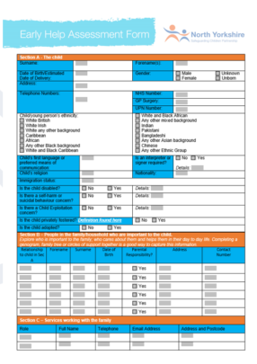
Using The Early Help Assessment
Based on Signs of Safety
Strength Based Approach
Completed early as soon as problems emerge or are identified
Formulates an Action Plan about how to meet need and prevent escalation
Can be used as a referral
https://www.safeguardingchildren.co.uk/professionals/early-help/

Slide 32
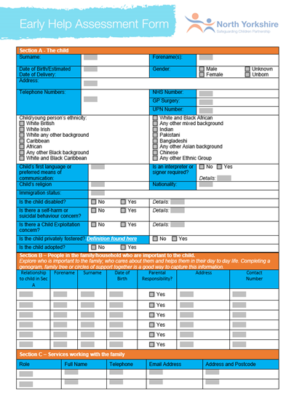
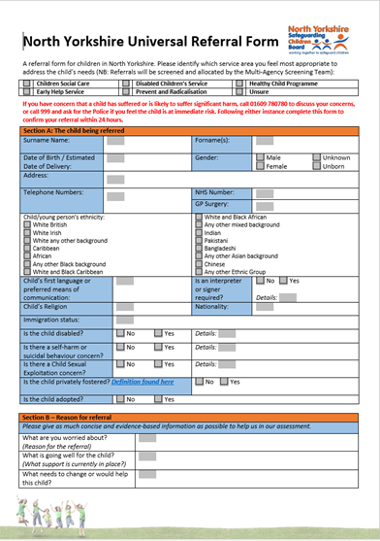

How to make a referral related to Hidden Harm
Speak with your Early Help Consultant first
Universal Referral Form
Early Help Assessment
Customer Contact Centre (01609 780780)
https://www.safeguardingchildren.co.uk/professionals/forms-for-professionals/

Slide 33
Early Help Contacts
Division | Name
Central (Selby, Richmondshire, Hambleton) Jon Coates, Liz Power, Cath Preston | 01609 534829
East (Scarborough, Whitby, Ryedale) Liz White, Kelly Trotter, James Urquhart | 01609 534852
West (Harrogate, Knaresborough, Craven, Ripon) Rachel Yeadon, Sarah Webb, Elaine Shaw, Angela Charlesworth | 01609 534842

Slide 34
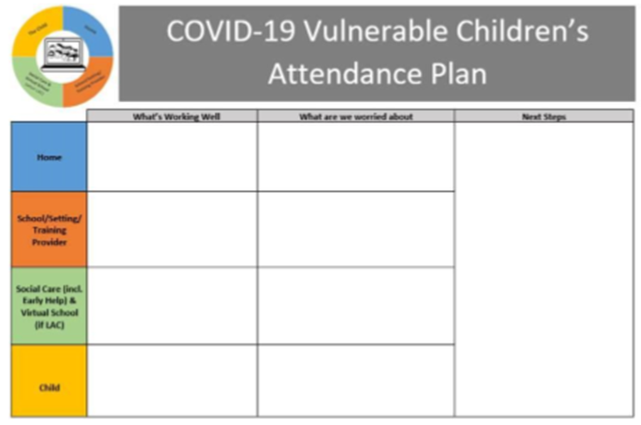
How is Children’s Social Care working with schools to identify and respond to Hidden Harm concerns?
Working with North Yorkshire Children’s Safeguarding Partnership to raise awareness about hidden harm
Continued visits and interventions to all children that are open to Children’s Social Care
Working with schools to ensure all vulnerable children, with a social worker or Disabled Children’s Service, have an attendance plan
Add image
  From: NYCC Guide to vulnerable children and young people Covid-19 attendance plan
  https://cyps.northyorks.gov.uk/covid-19

Slide 35


For more information on the NYSCP Hidden Harm Strategy and Campaign materials
Visit North Yorkshire Safeguarding Children Partnership website
  www.safeguardingchildren.co.uk
Hidden Harm twilight online sessions for schools 4-5pm ( this presentation and opportunities for questions/sharing practice) - joining instructions to be confirmed
Hidden Harm will be a theme in the Headteacher/Designated Safeguarding Lead Networks in Autumn term 2020 (likely to be webinar based/online)
Mon 6th July | East
Tues 7th July | West
Weds 8th July | Central
Sign up to NYSCP e-Bulletin

Slide 36

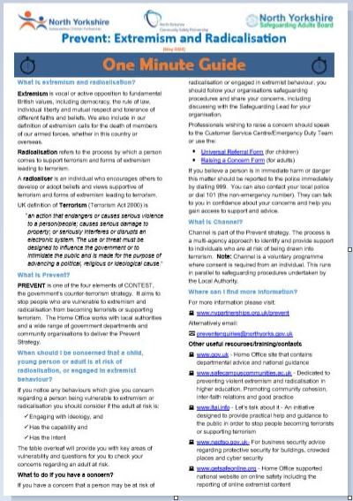
Future Hidden Harm Campaign Resources
Hidden Harm posters
Hidden Harm video
New Hidden Harm related one minute guides
  o Parental Mental Ill Health (New)
  o Prevent: Extremism and Radicalisation (New)
  o Mate Crime (New)
  o Stalking Protection Orders (New)
  o Forced Marriage (New)
  o County Lines and Cuckooing (Revised)
  o Female Genital Mutilation (Revised)
  o Information Sharing (Revised)
  o Social Media and Professionals (Revised)
https://www.safeguardingchildren.co.uk/professionals/one-minute-guides/

Slide 37
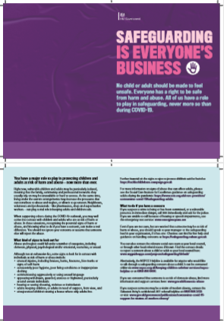

National Campaign Resources
No child or adult should be made to feel unsafe. Everyone has a right to be safe from harm and abuse. All of us have a role to play in safeguarding, never more so than during COVID-19
North Yorkshire schools - Any notifications of concerns/referrals should be made through local safeguarding procedures
https://tacklechildabuse.campaign.gov.uk/

Slide 38
Final Questions/Sharing Practice
Questions
School Practice

